Slide 1
Chapter 9 Object-Oriented Programming: Inheritance
Java How to Program, 11/e
Questions? E-mail paul.deitel@deitel.com

Slide 2

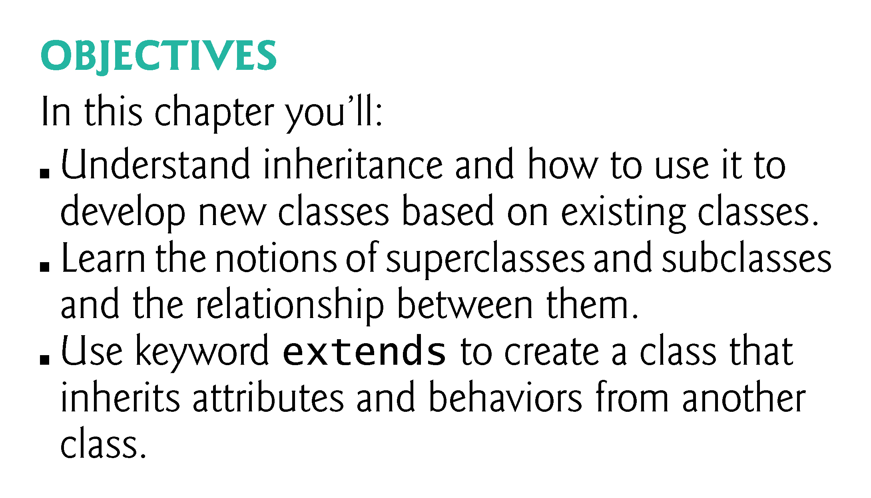

Slide 3
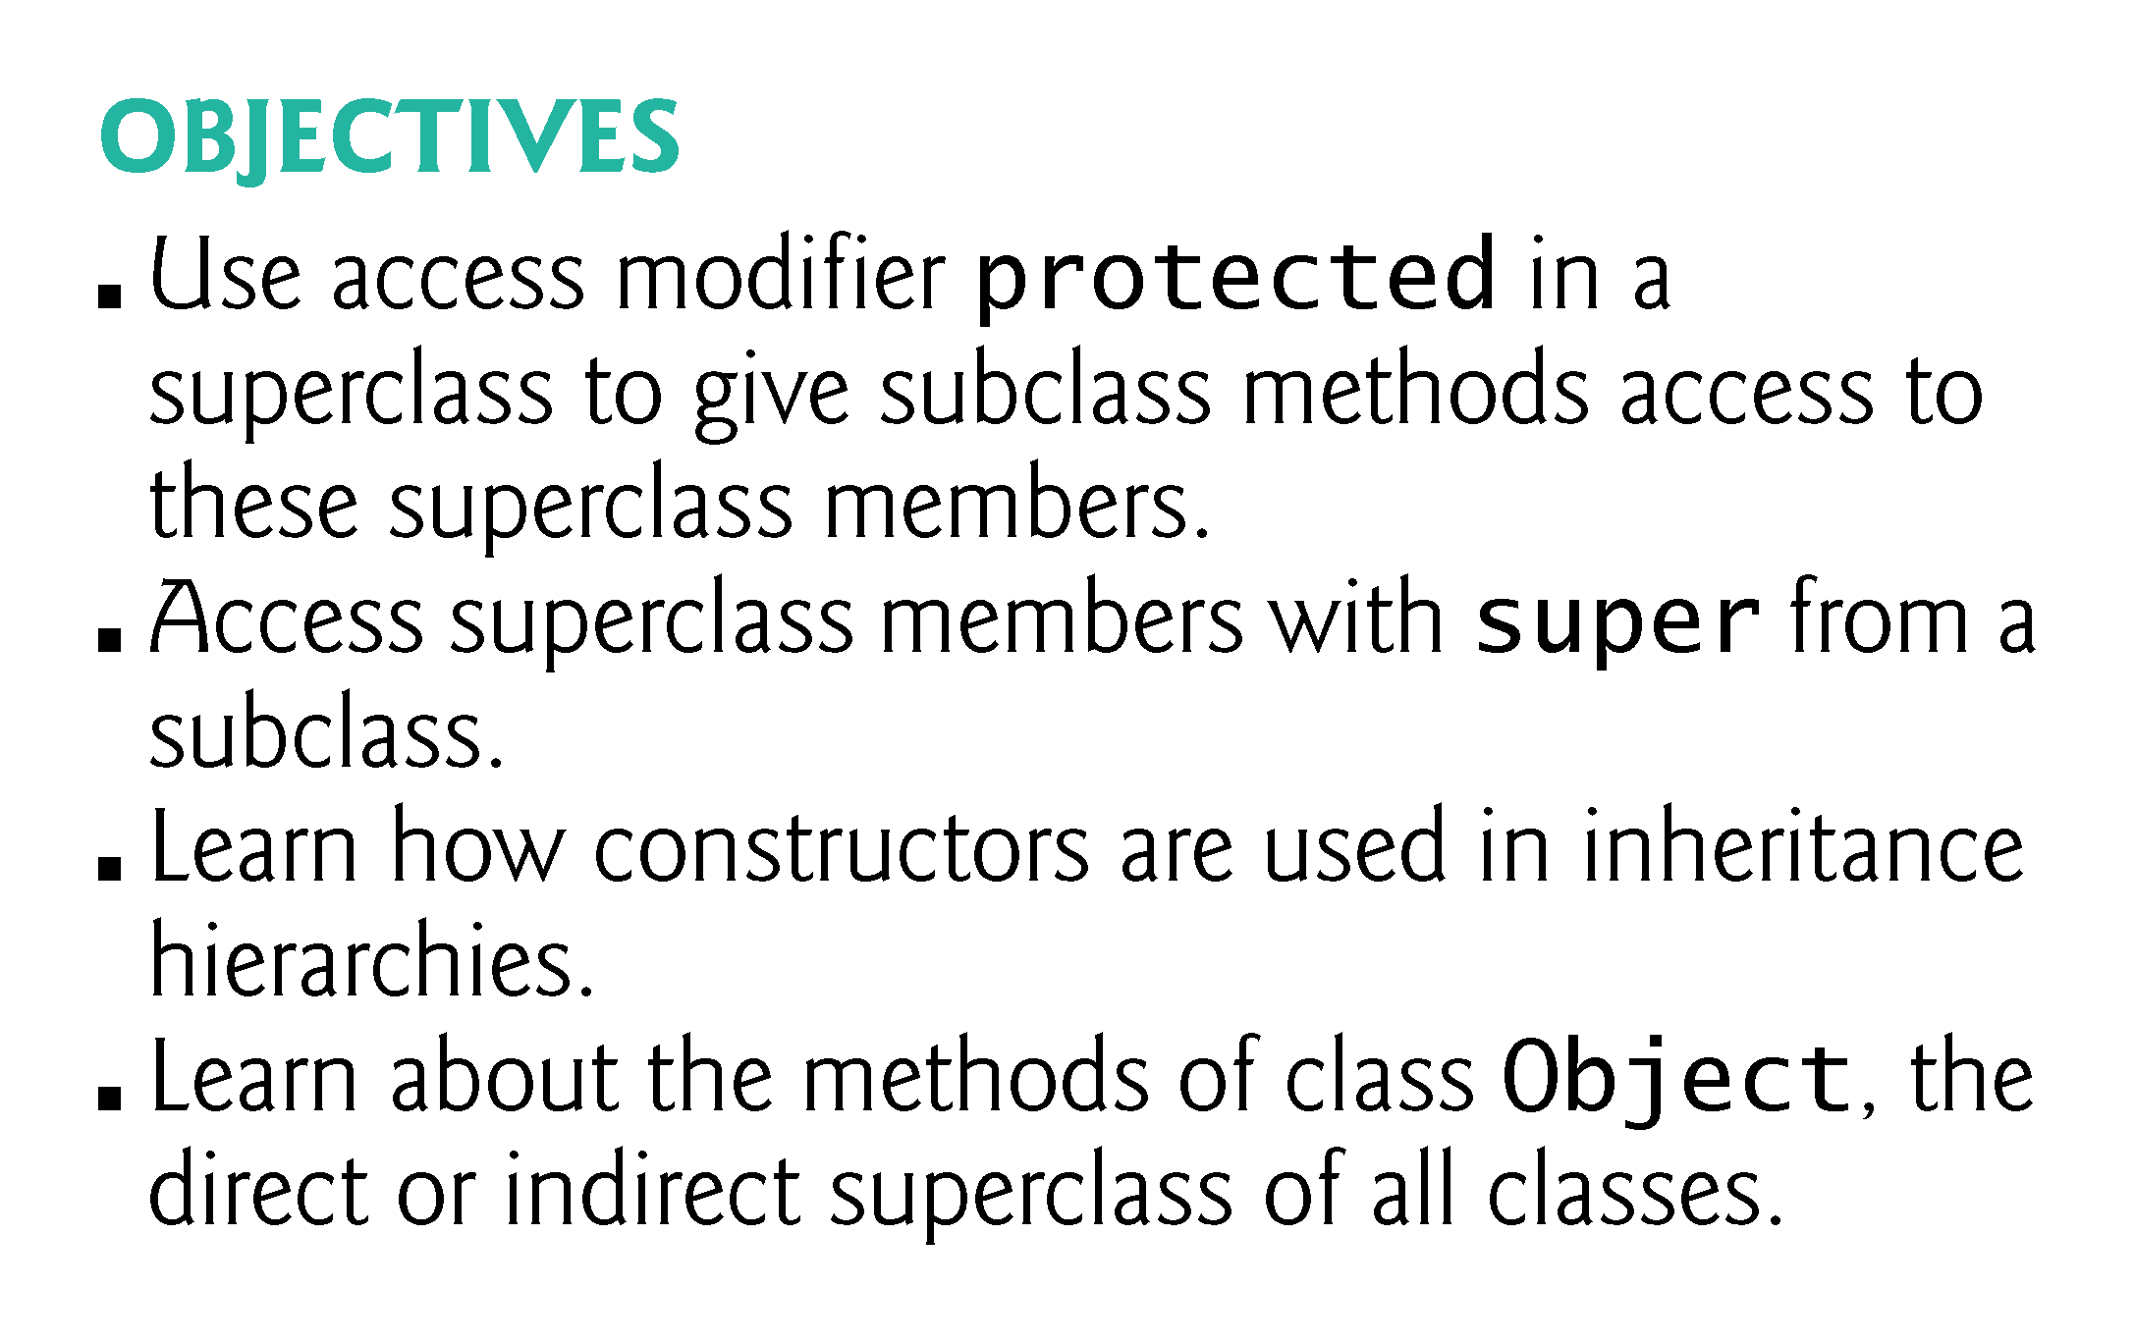

Slide 4
9.1 Introduction
Inheritance
A new class is created by acquiring an existing class’s members and possibly embellishing them with new or modified capabilities.
Can save time during program development by basing new classes on existing proven and debugged high-quality software.
Increases the likelihood that a system will be implemented and maintained effectively.

Slide 5
9.1 Introduction (Cont.)
When creating a class, rather than declaring completely new members, you can designate that the new class should inherit the members of an existing class.
Existing class is the superclass
New class is the subclass
A subclass can be a superclass of future subclasses.
A subclass can add its own fields and methods.
The subclass exhibits the behaviors of its superclass and can add behaviors that are specific to the subclass.
This is why inheritance is sometimes referred to as specialization.

Slide 6
9.1 Introduction (Cont.)
The direct superclass is the superclass from which the subclass explicitly inherits.
An indirect superclass is any class above the direct superclass in the class hierarchy.
The Java class hierarchy begins with class Object (in package java.lang)
Every class in Java directly or indirectly extends (or “inherits from”) Object.
Java supports only single inheritance, in which each class is derived from exactly one direct superclass.

Slide 7
9.1 Introduction (Cont.)
We distinguish between the is-a relationship and the has-a relationship
Is-a represents inheritance
In an is-a relationship, an object of a subclass can also be treated as an object of its superclass
Has-a represents composition
In a has-a relationship, an object contains as members references to other objects

Slide 8
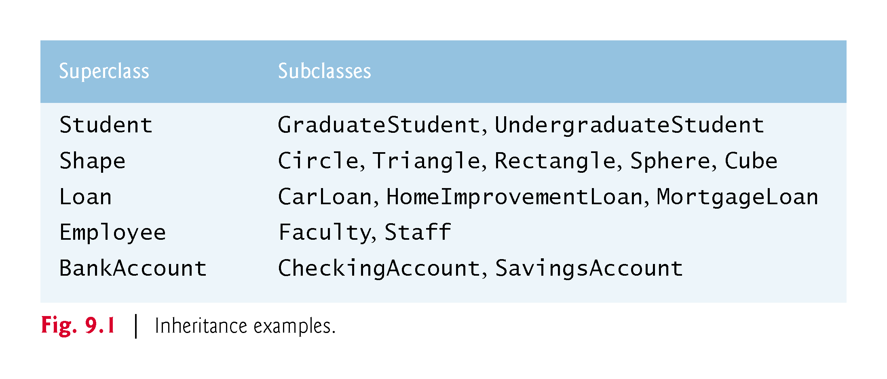

Slide 9
9.2 Superclasses and Subclasses
Figure 9.1 lists several simple examples of superclasses and subclasses
Superclasses tend to be “more general” and subclasses “more specific.”
Because every subclass object is an object of its superclass, and one superclass can have many subclasses, the set of objects represented by a superclass is typically larger than the set of objects represented by any of its subclasses.
The subclass can override (redefine) the superclass method with an appropriate implementation.

Slide 10
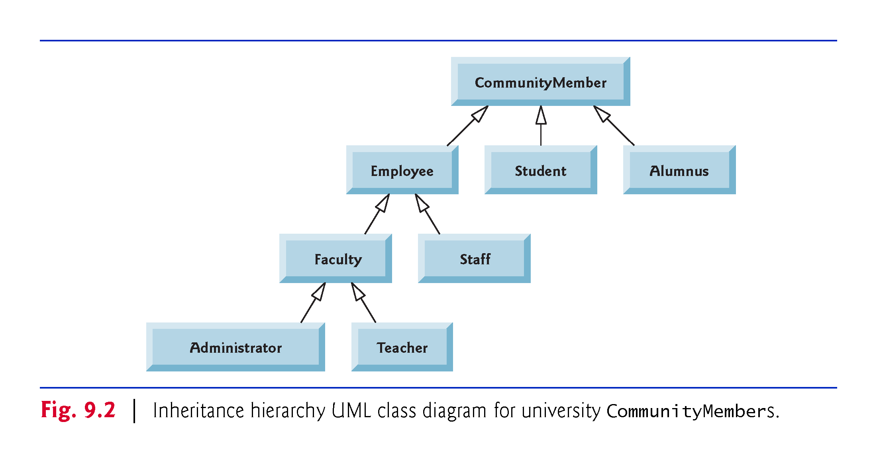

Slide 11
9.2 Superclasses and Subclasses (Cont.)
A superclass exists in a hierarchical relationship with its subclasses.
Fig. 9.2 shows a sample university community class hierarchy
Also called an inheritance hierarchy.
Each arrow in the hierarchy represents an is-a relationship.
Follow the arrows upward in the class hierarchy
an Employee is a CommunityMember”
“a Teacher is a Faculty member.”
CommunityMember is the direct superclass of Employee, Student and Alumnus and is an indirect superclass of all the other classes in the diagram.
Starting from the bottom, you can follow the arrows and apply the is-a relationship up to the topmost superclass.

Slide 12
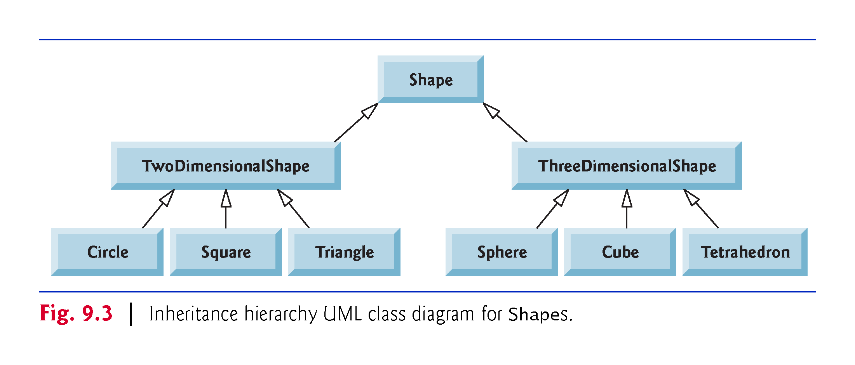

Slide 13
9.2 Superclasses and Subclasses (Cont.)
Fig. 9.3 shows a Shape inheritance hierarchy.
Van follow the arrows from the bottom of the diagram to the topmost superclass in this class hierarchy to identify several is-a relationships.
A Triangle is a TwoDimensionalShape and is a Shape
ASphere is a ThreeDimensionalShape and is a Shape.

Slide 14
9.2 Superclasses and Subclasses (Cont.)
Not every class relationship is an inheritance relationship.
Has-a relationship
Create classes by composition of existing classes.
Example: Given the classes Employee, BirthDate and TelephoneNumber, it’s improper to say that an Employee is a BirthDate or that an Employee is a TelephoneNumber.
However, an Employee has a BirthDate, and an Employee has a TelephoneNumber.

Slide 15
9.3 protected Members
A class’s public members are accessible wherever the program has a reference to an object of that class or one of its subclasses.
A class’s private members are accessible only within the class itself.
protected access is an intermediate level of access between public and private.
A superclass’s protected members can be accessed by members of that superclass, by members of its subclasses and by members of other classes in the same package
protected members also have package access.
All public and protected superclass members retain their original access modifier when they become members of the subclass.

Slide 16
9.3 protected Members (Cont.)
A superclass’s private members are hidden from its subclasses
They can be accessed only through the public or protected methods inherited from the superclass
Subclass methods can refer to public and protected members inherited from the superclass simply by using the member names.
When a subclass method overrides an inherited superclass method, the superclass version of the method can be accessed from the subclass by preceding the superclass method name with keyword super and a dot (.) separator.

Slide 17
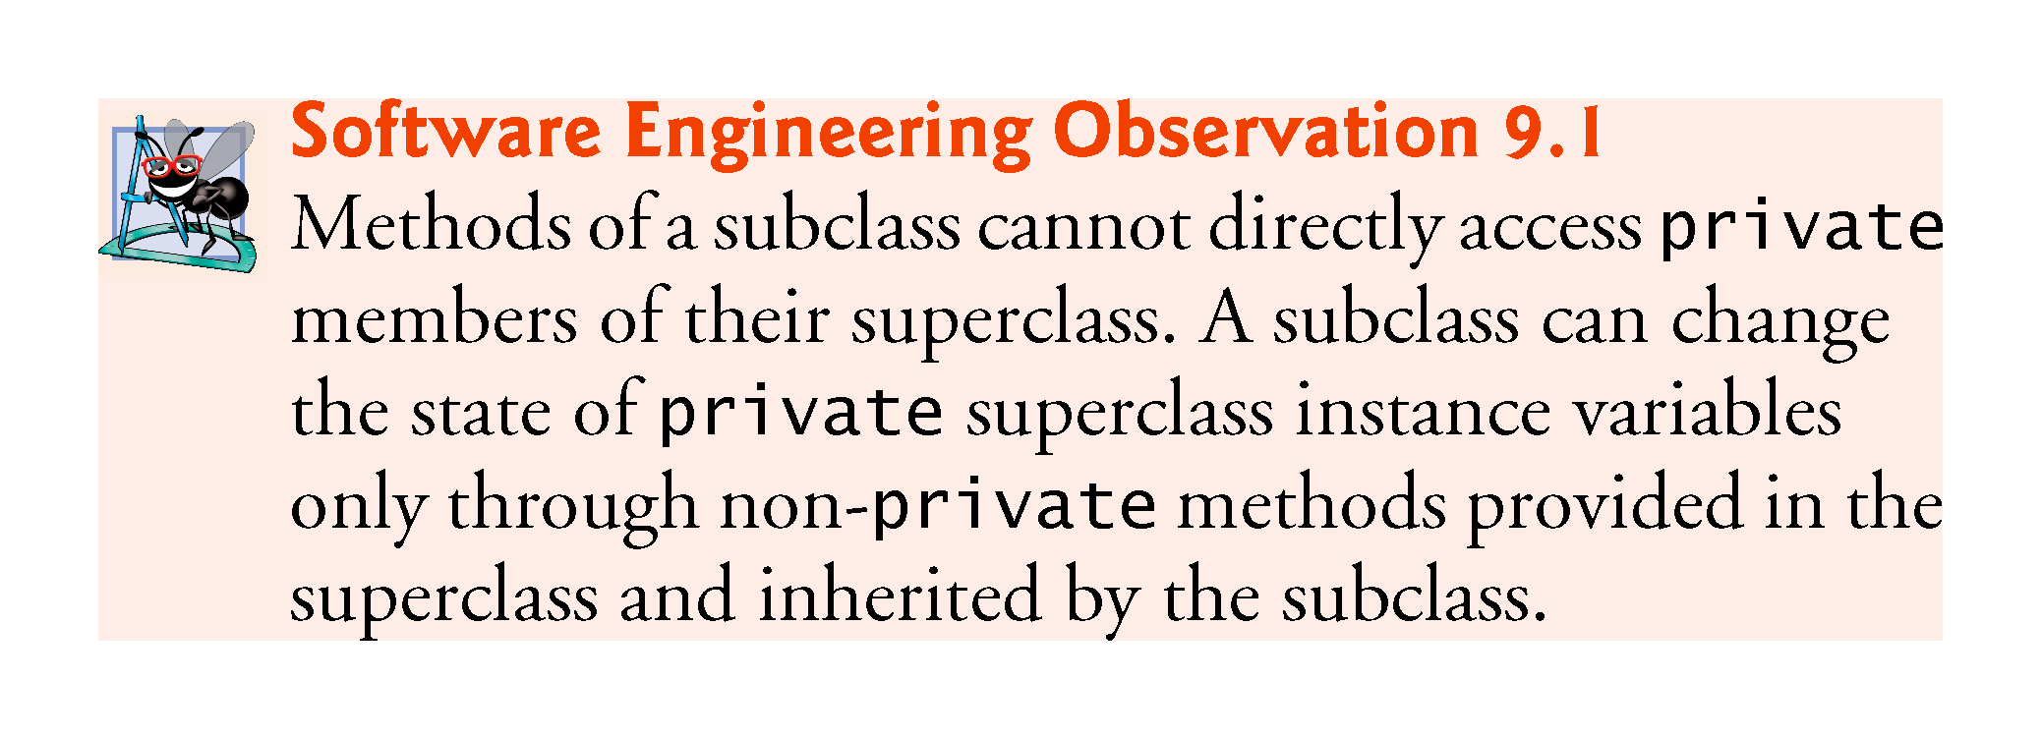

Slide 18
9.4 Relationship Between Superclasses and Subclasses
Inheritance hierarchy containing types of employees in a company’s payroll application
Commission employees are paid a percentage of their sales
Base-salaried commission employees receive a base salary plus a percentage of their sales.

Slide 19
9.4.1 Creating and Using a CommissionEmployee Class
Class CommissionEmployee (Fig. 9.4) extends class Object (from package java.lang).
CommissionEmployee inherits Object’s methods.
If you don’t explicitly specify which class a new class extends, the class extends Object implicitly.

Slide 20
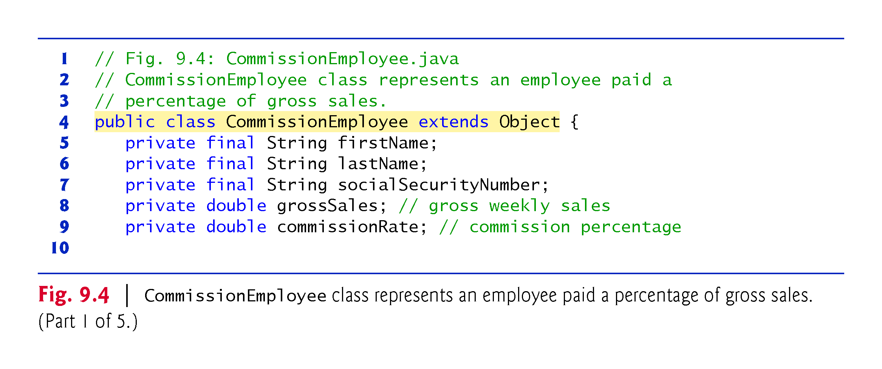

Slide 21
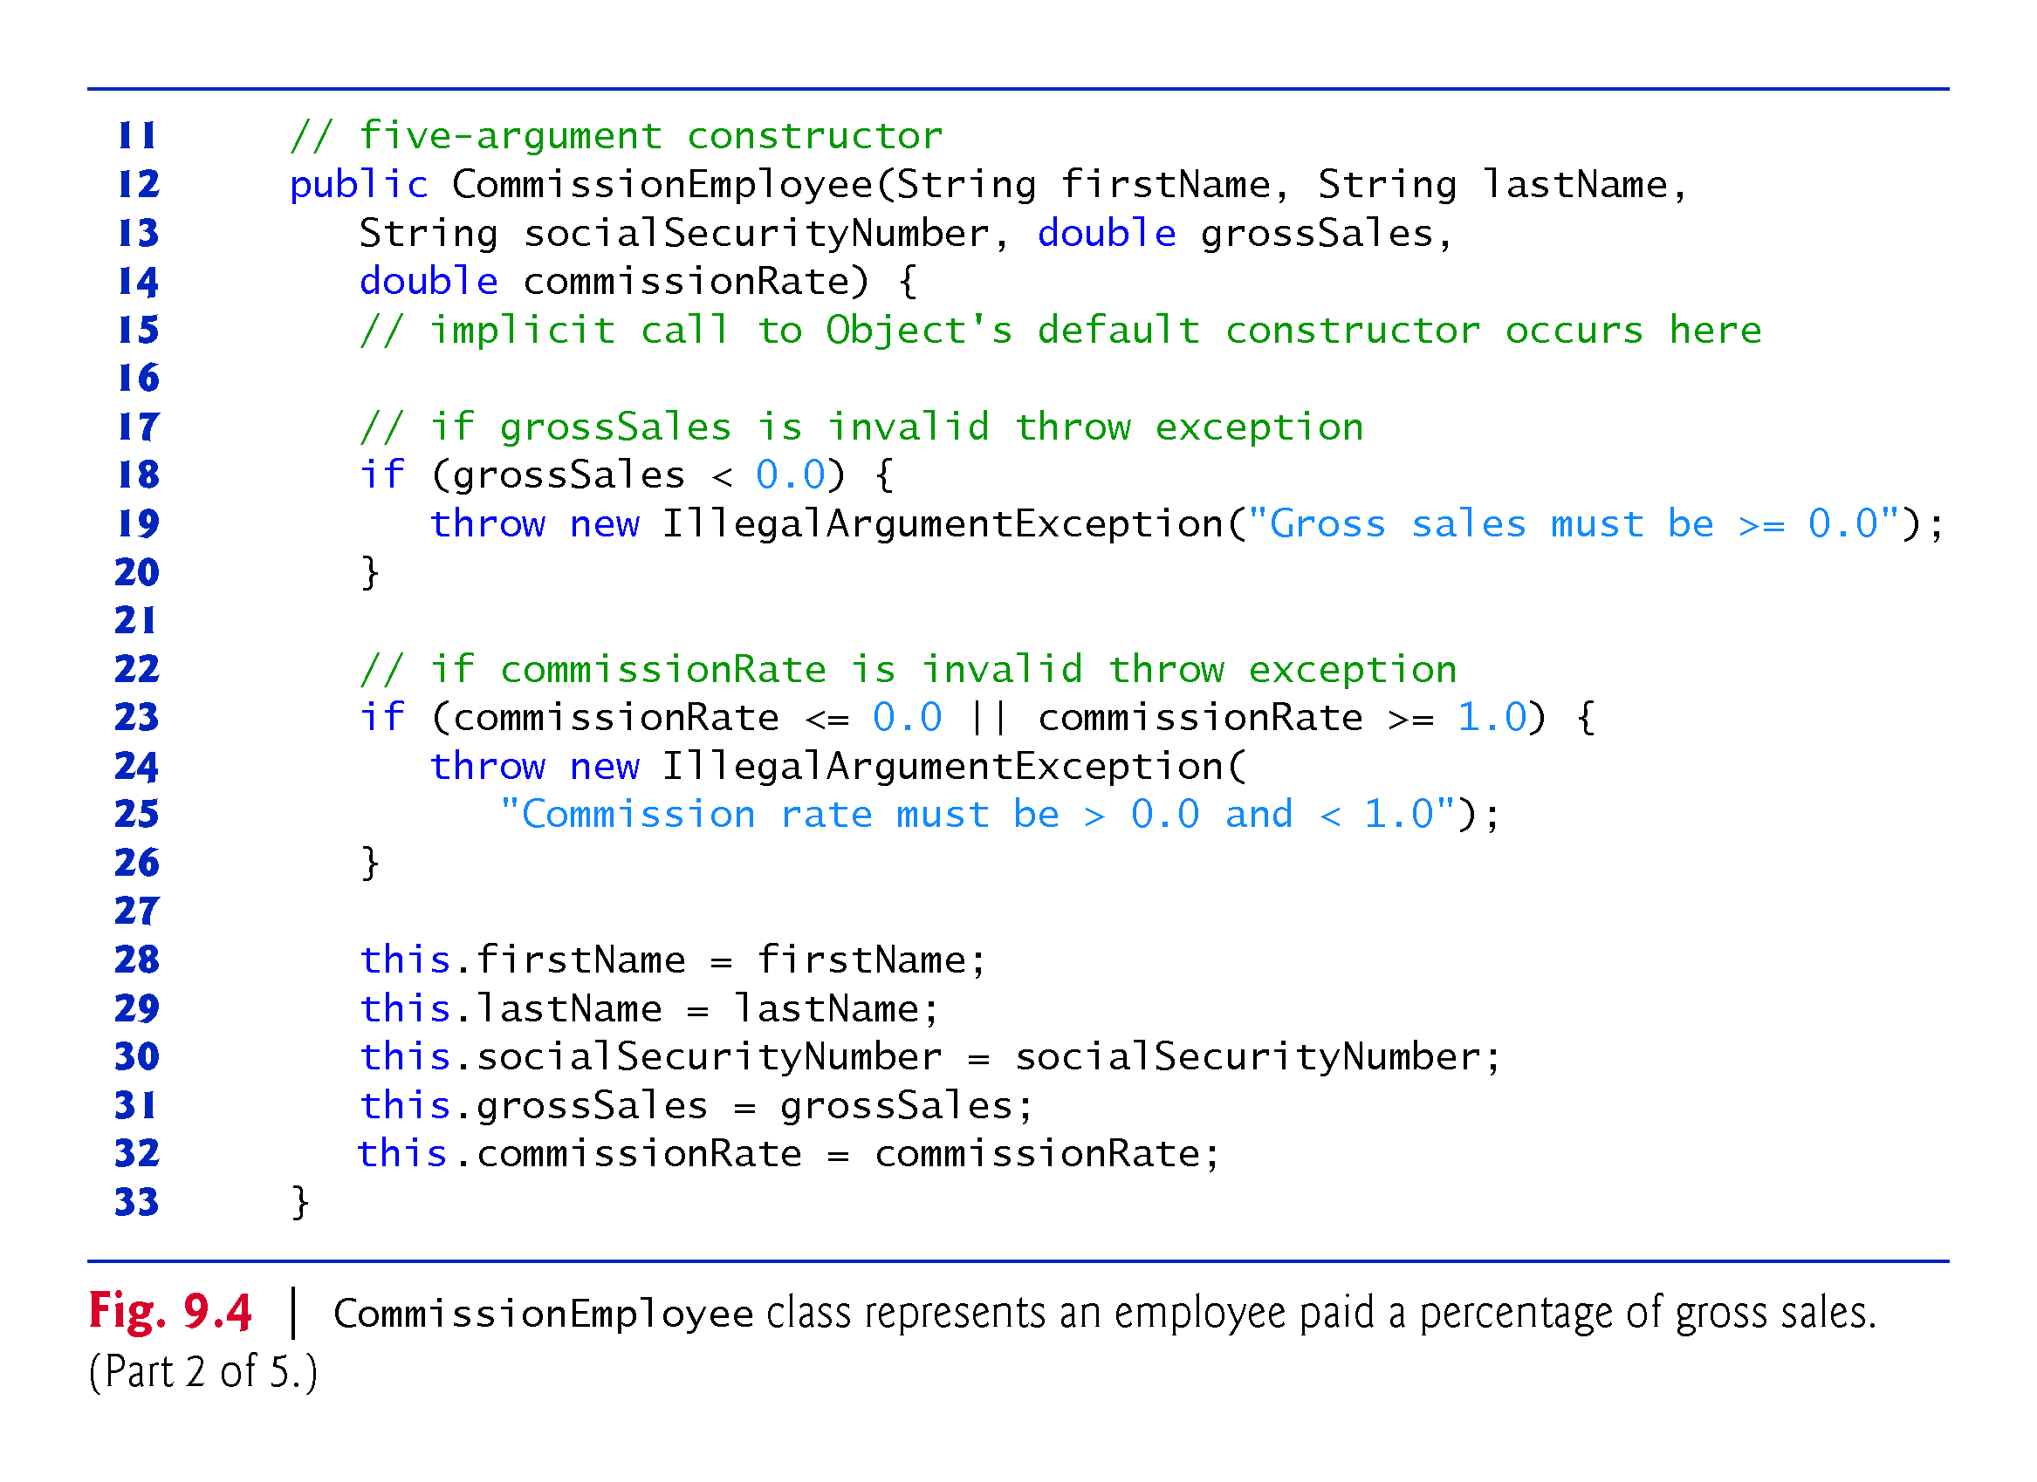

Slide 22
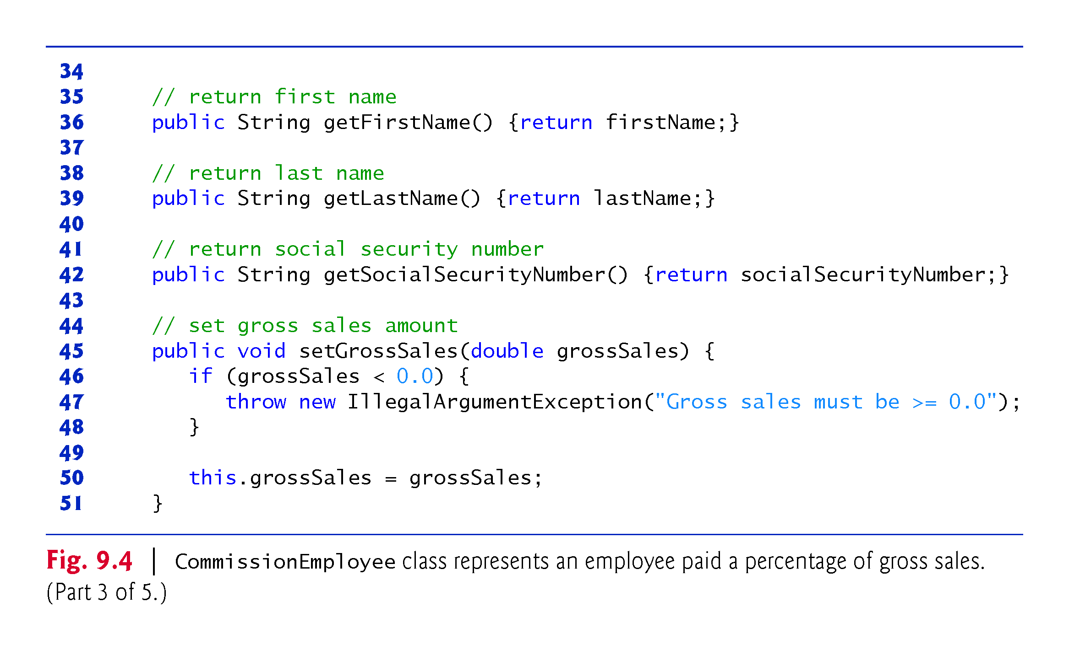

Slide 23
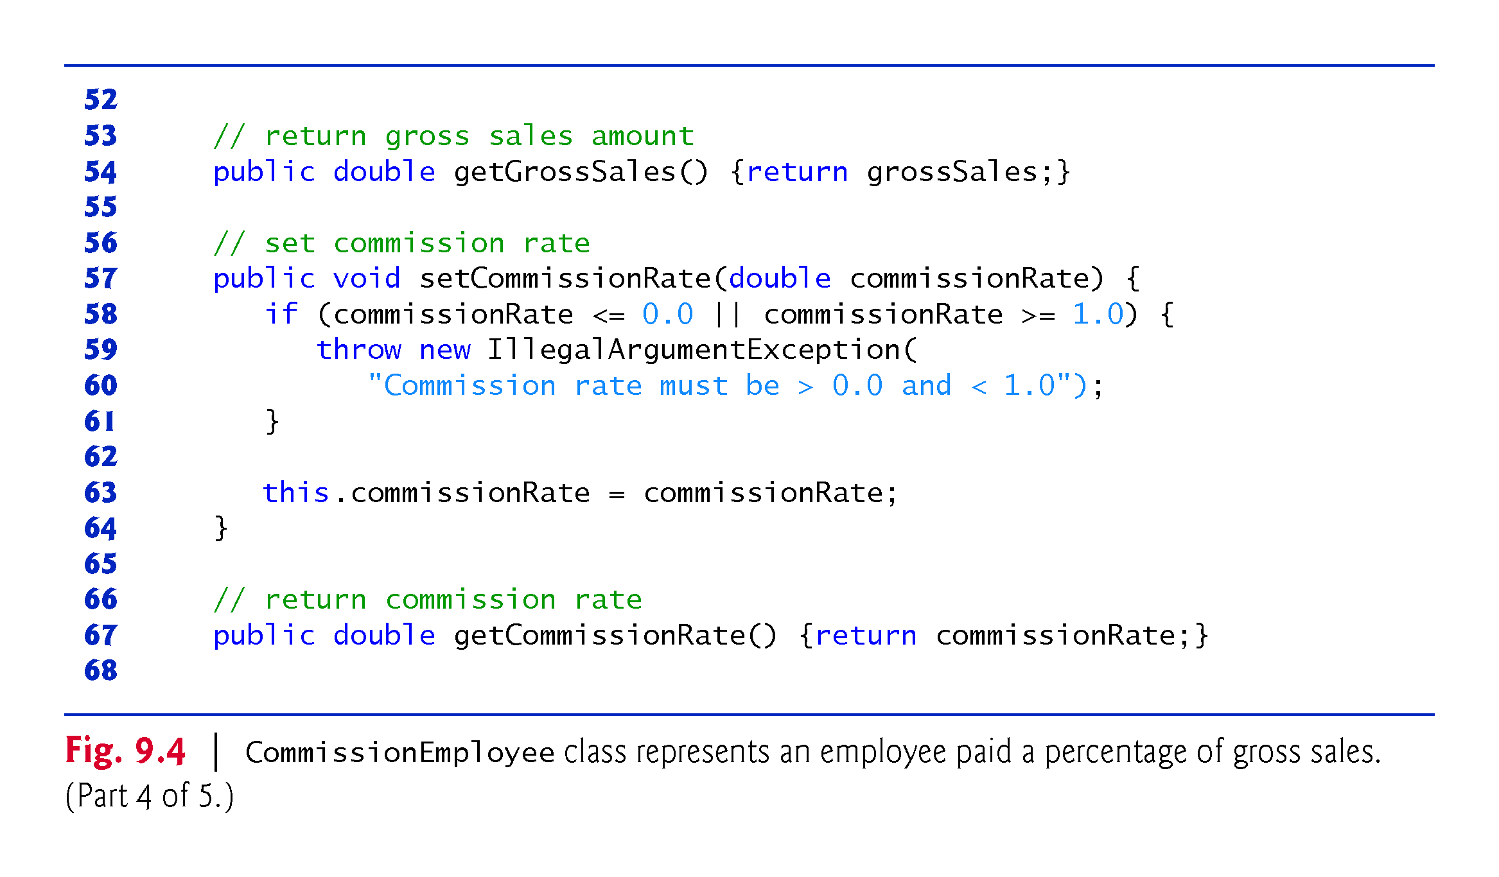

Slide 24
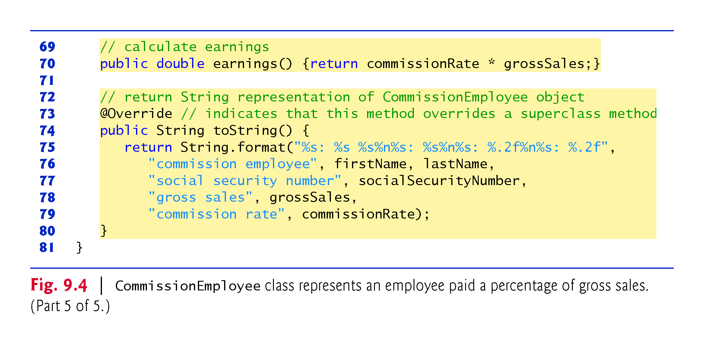

Slide 25
9.4.1 Creating and Using a CommissionEmployee Class (Cont.)
Constructors are not inherited.
The first task of a subclass constructor is to call its direct superclass’s constructor explicitly or implicitly
Ensures that the instance variables inherited from the superclass are initialized properly.
If the code does not include an explicit call to the superclass constructor, Java implicitly calls the superclass’s default or no-argument constructor.
A class’s default constructor calls the superclass’s default or no-argument constructor.

Slide 26
9.4.1 Creating and Using a CommissionEmployee Class (Cont.)
toString is one of the methods that every class inherits directly or indirectly from class Object.
Returns a String representing an object.
Called implicitly whenever an object must be converted to a String representation.
Class Object’s toString method returns a String that includes the name of the object’s class.
This is primarily a placeholder that can be overridden by a subclass to specify an appropriate String representation.

Slide 27
9.4.1 Creating and Using a CommissionEmployee Class (Cont.)
To override a superclass method, a subclass must declare a method with the same signature as the superclass method
@Override annotation
Indicates that a method should override a superclass method with the same signature.
If it does not, a compilation error occurs.

Slide 28
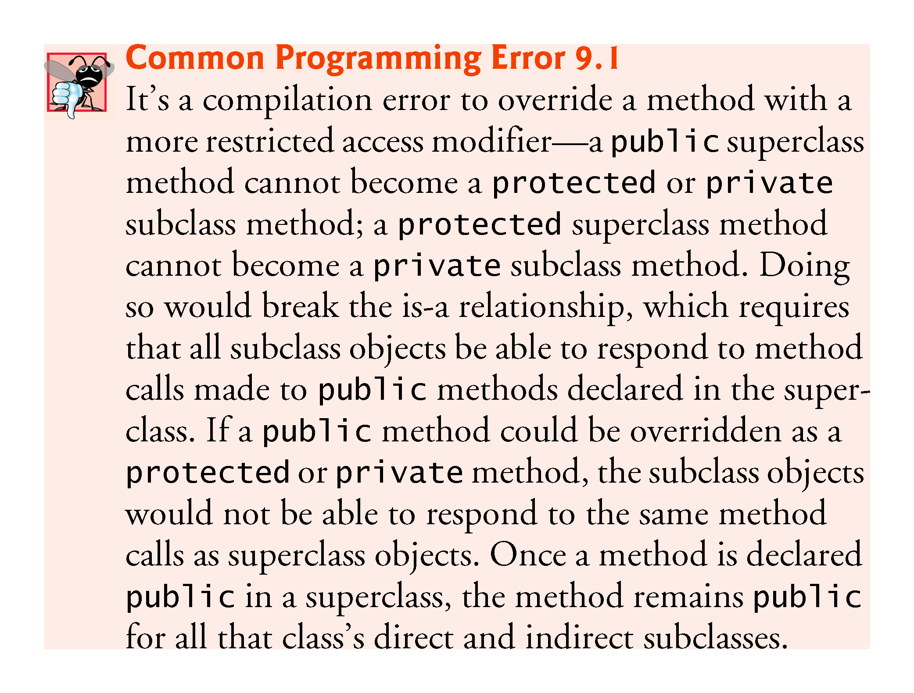

Slide 29
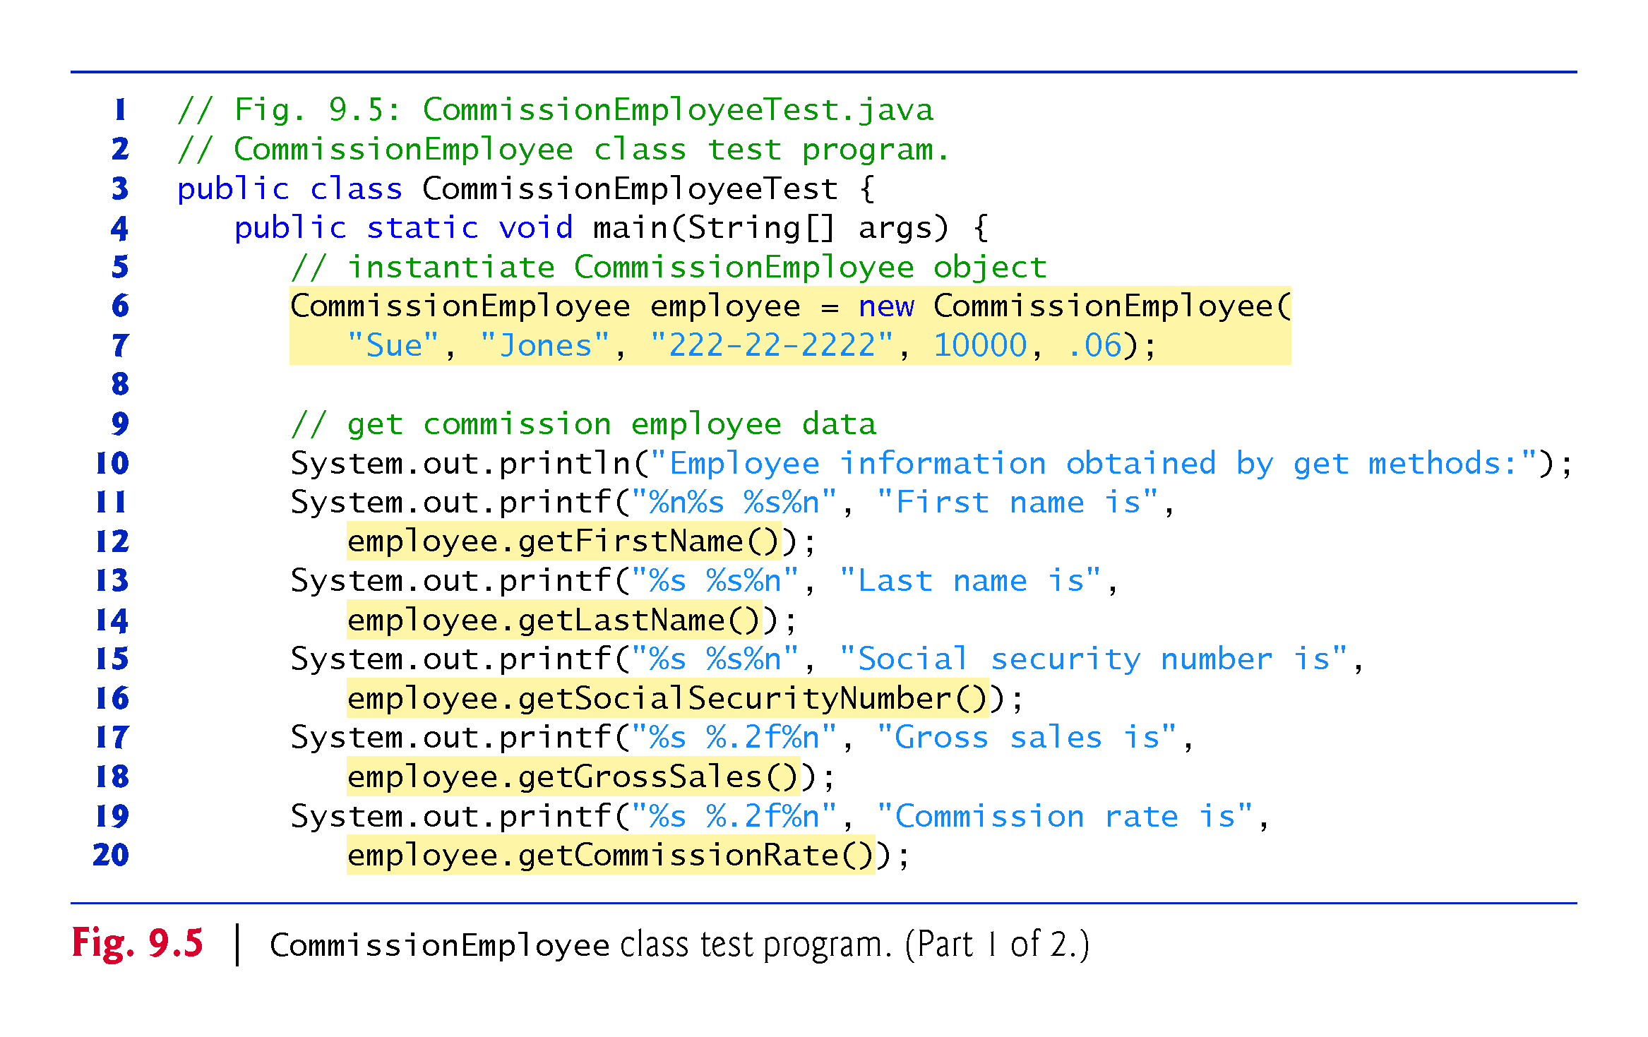

Slide 30
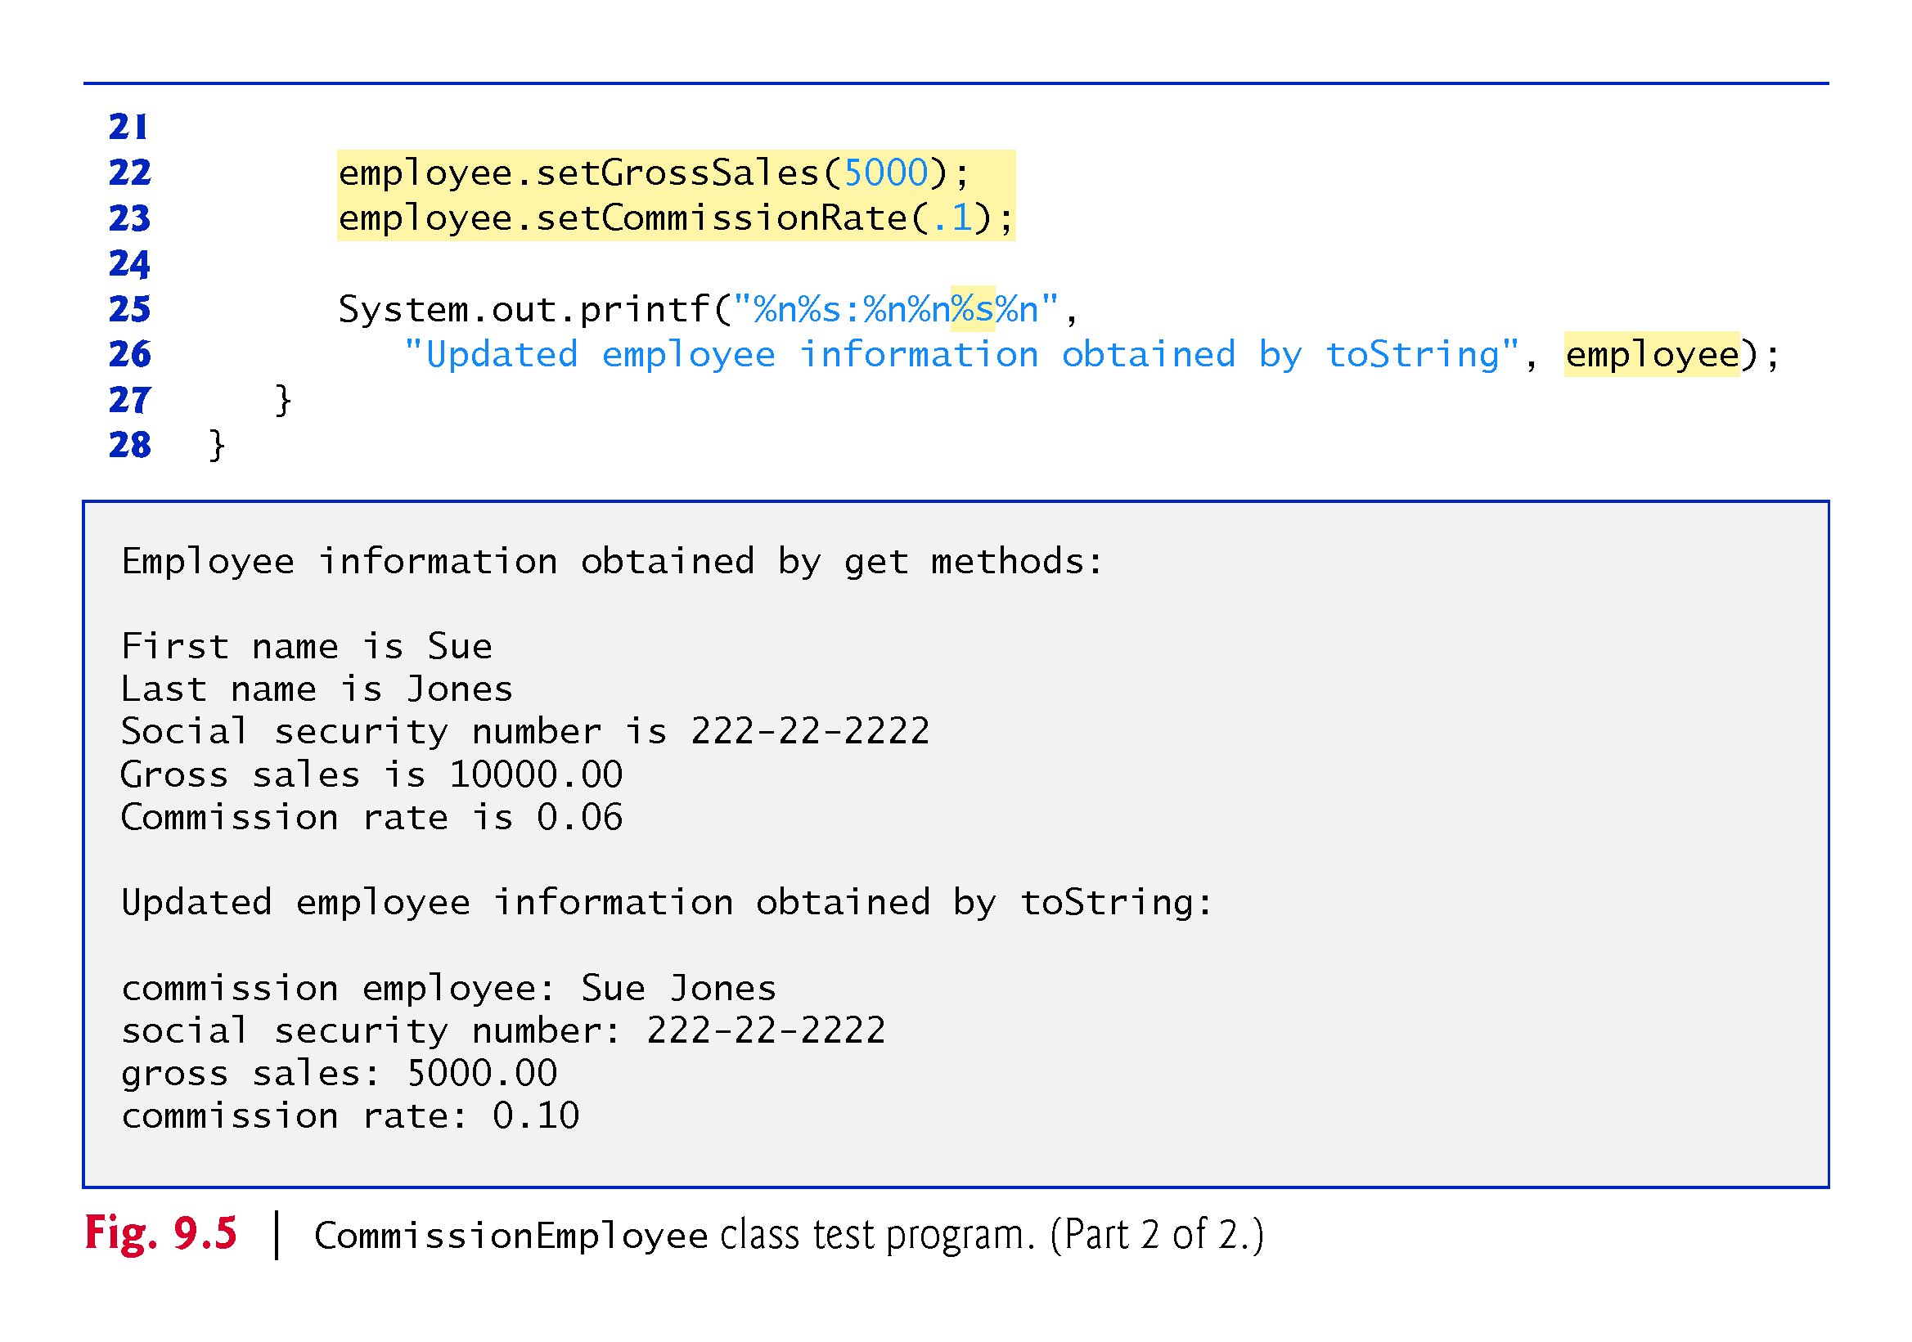

Slide 31
9.4.2 Creating and Using a BasePlus-CommissionEmployee Class
Class BasePlusCommissionEmployee (Fig. 9.6) contains a first name, last name, social security number, gross sales amount, commission rate and base salary.
All but the base salary are in common with class CommissionEmployee.
Class BasePlusCommissionEmployee’s public services include a constructor, and methods earnings, toString and get and set for each instance variable
Most of these are in common with class CommissionEmployee.

Slide 32
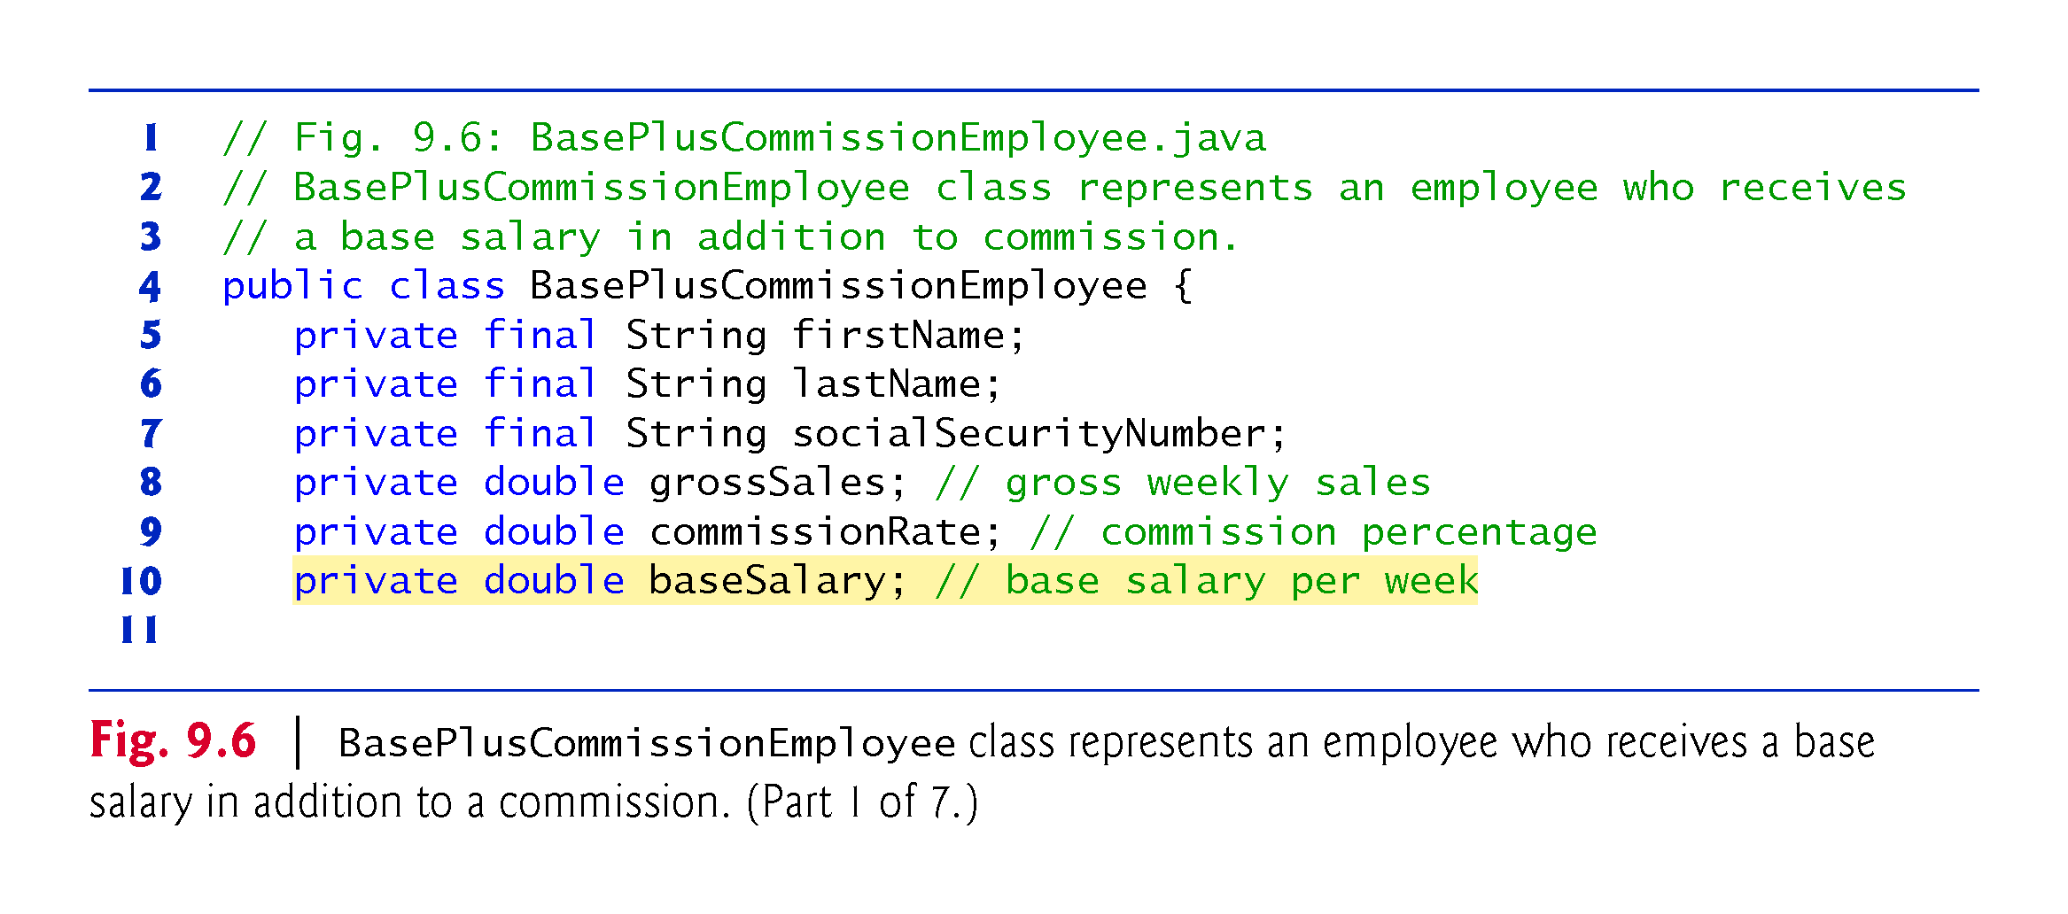

Slide 33
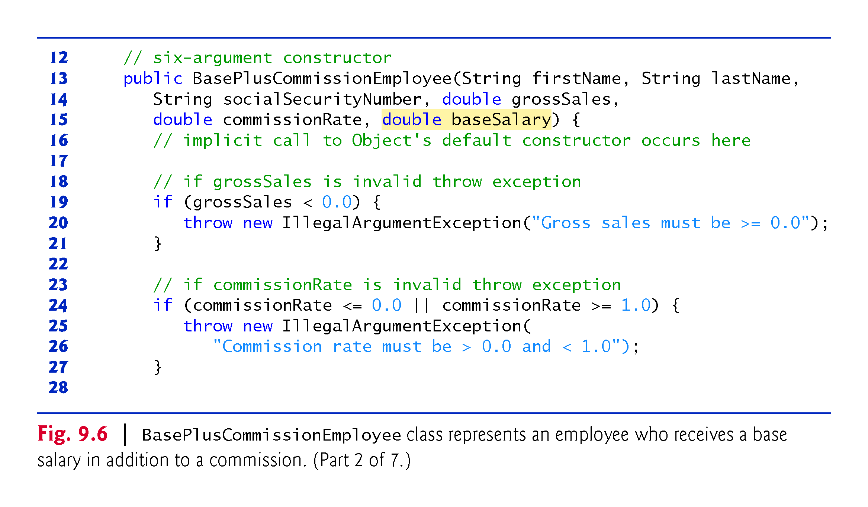

Slide 34
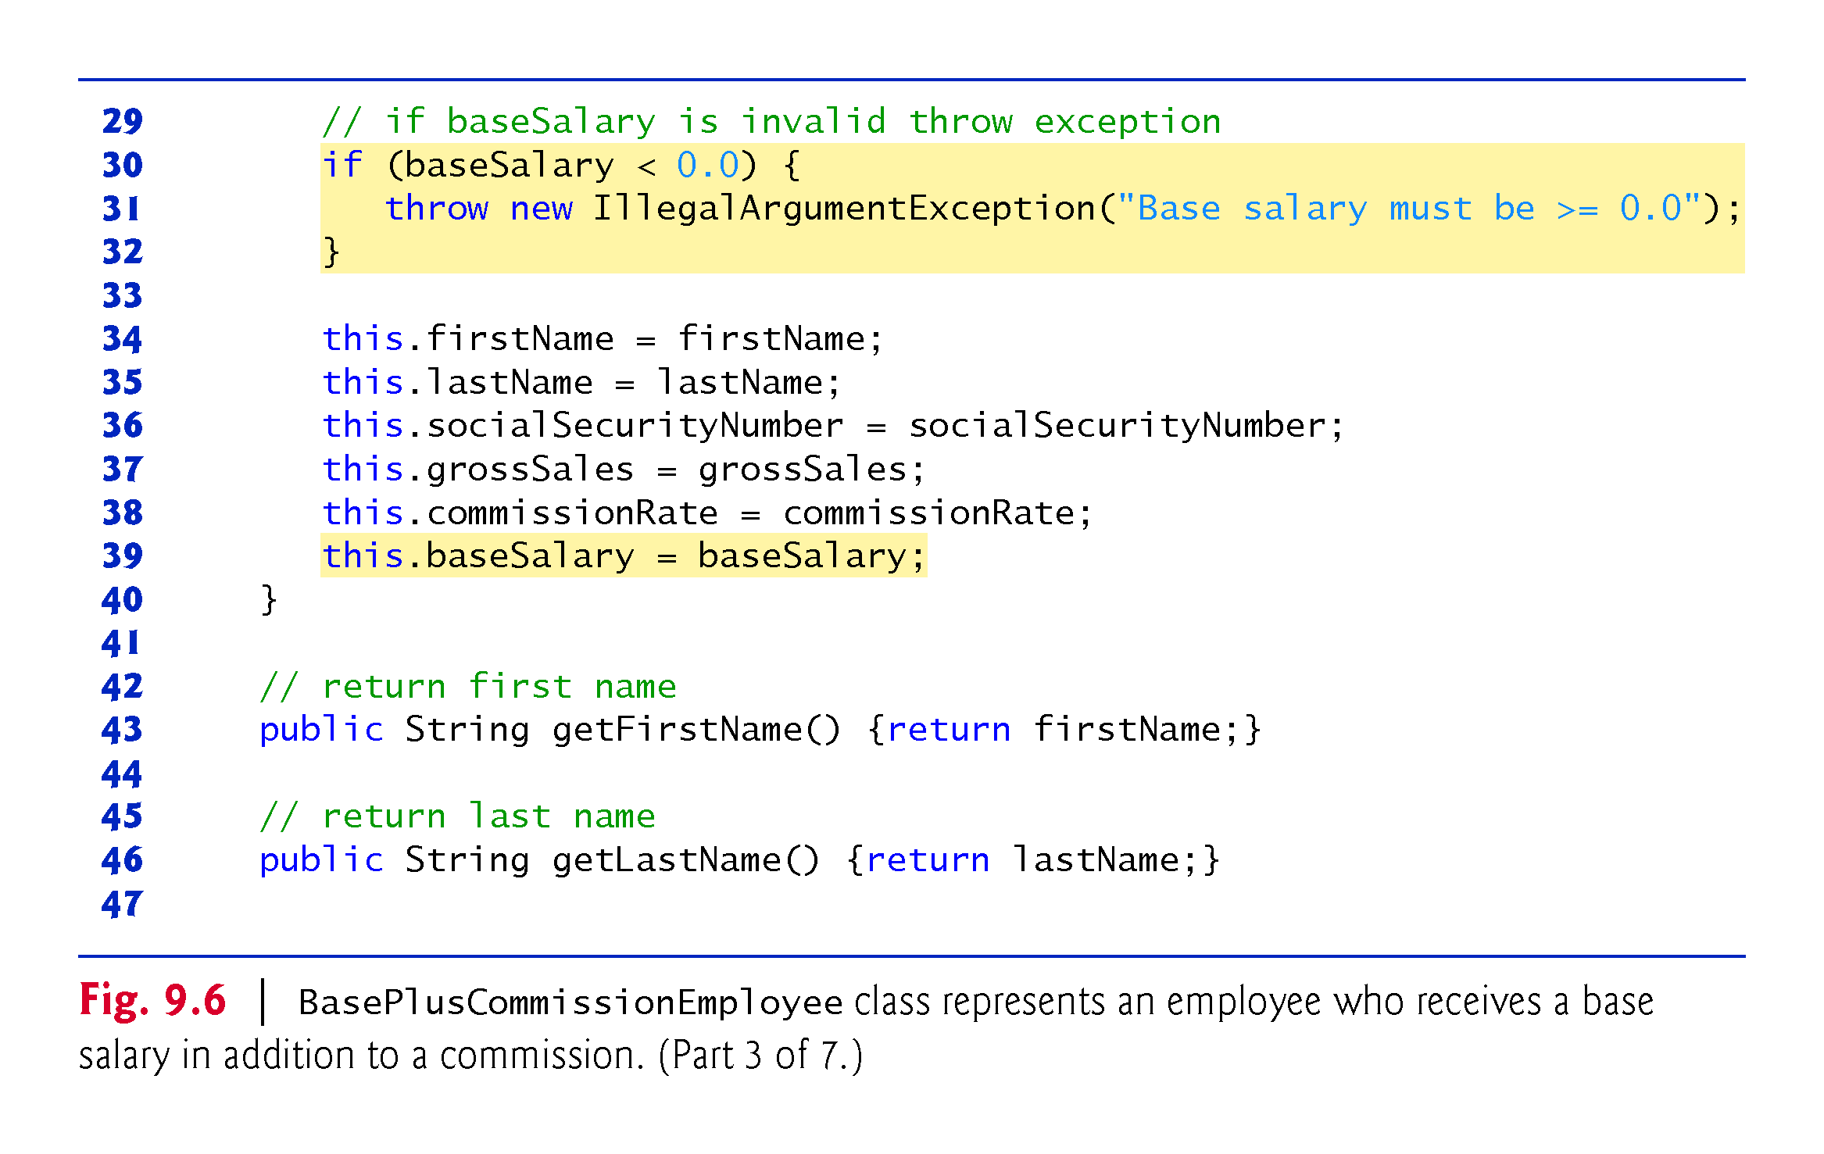

Slide 35
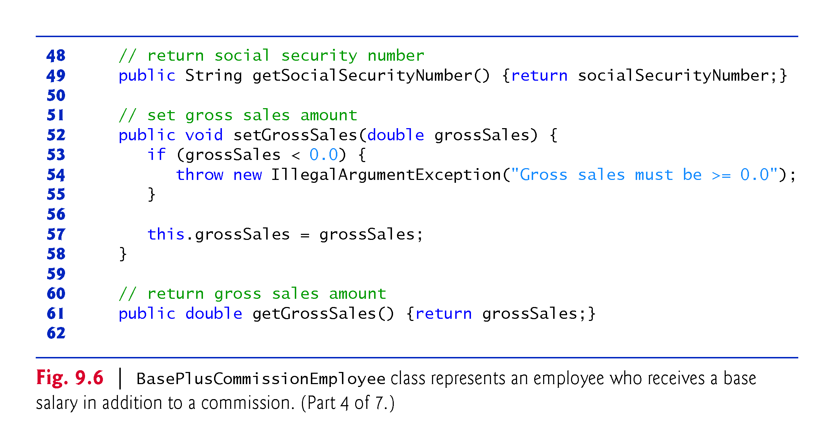

Slide 36
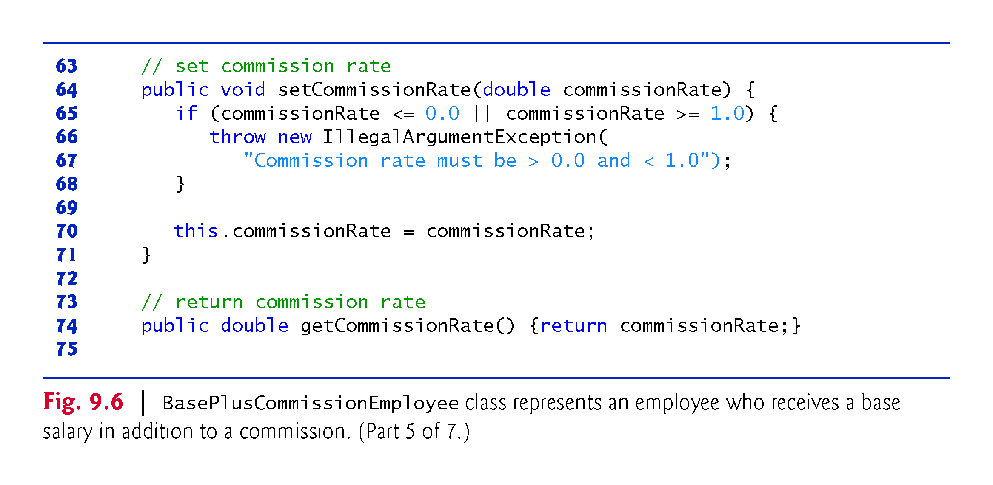

Slide 37
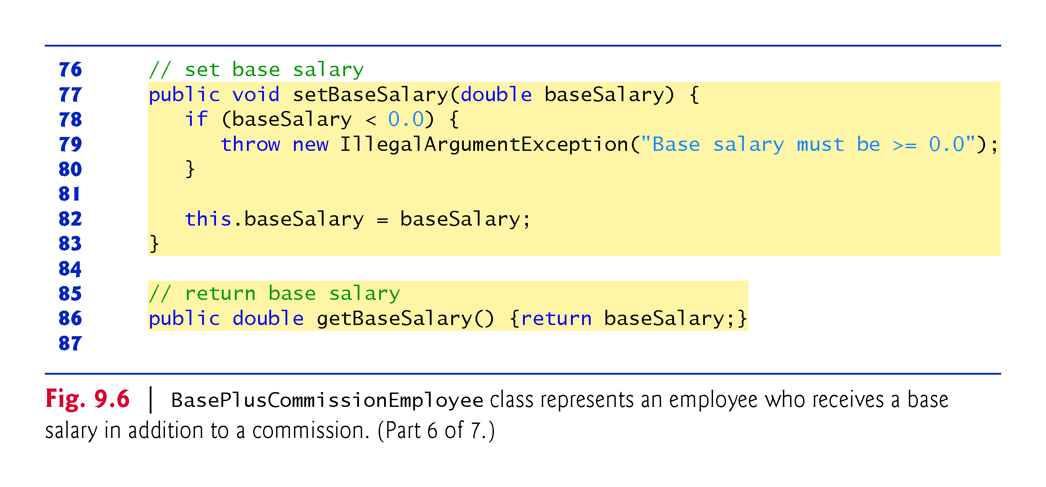

Slide 38
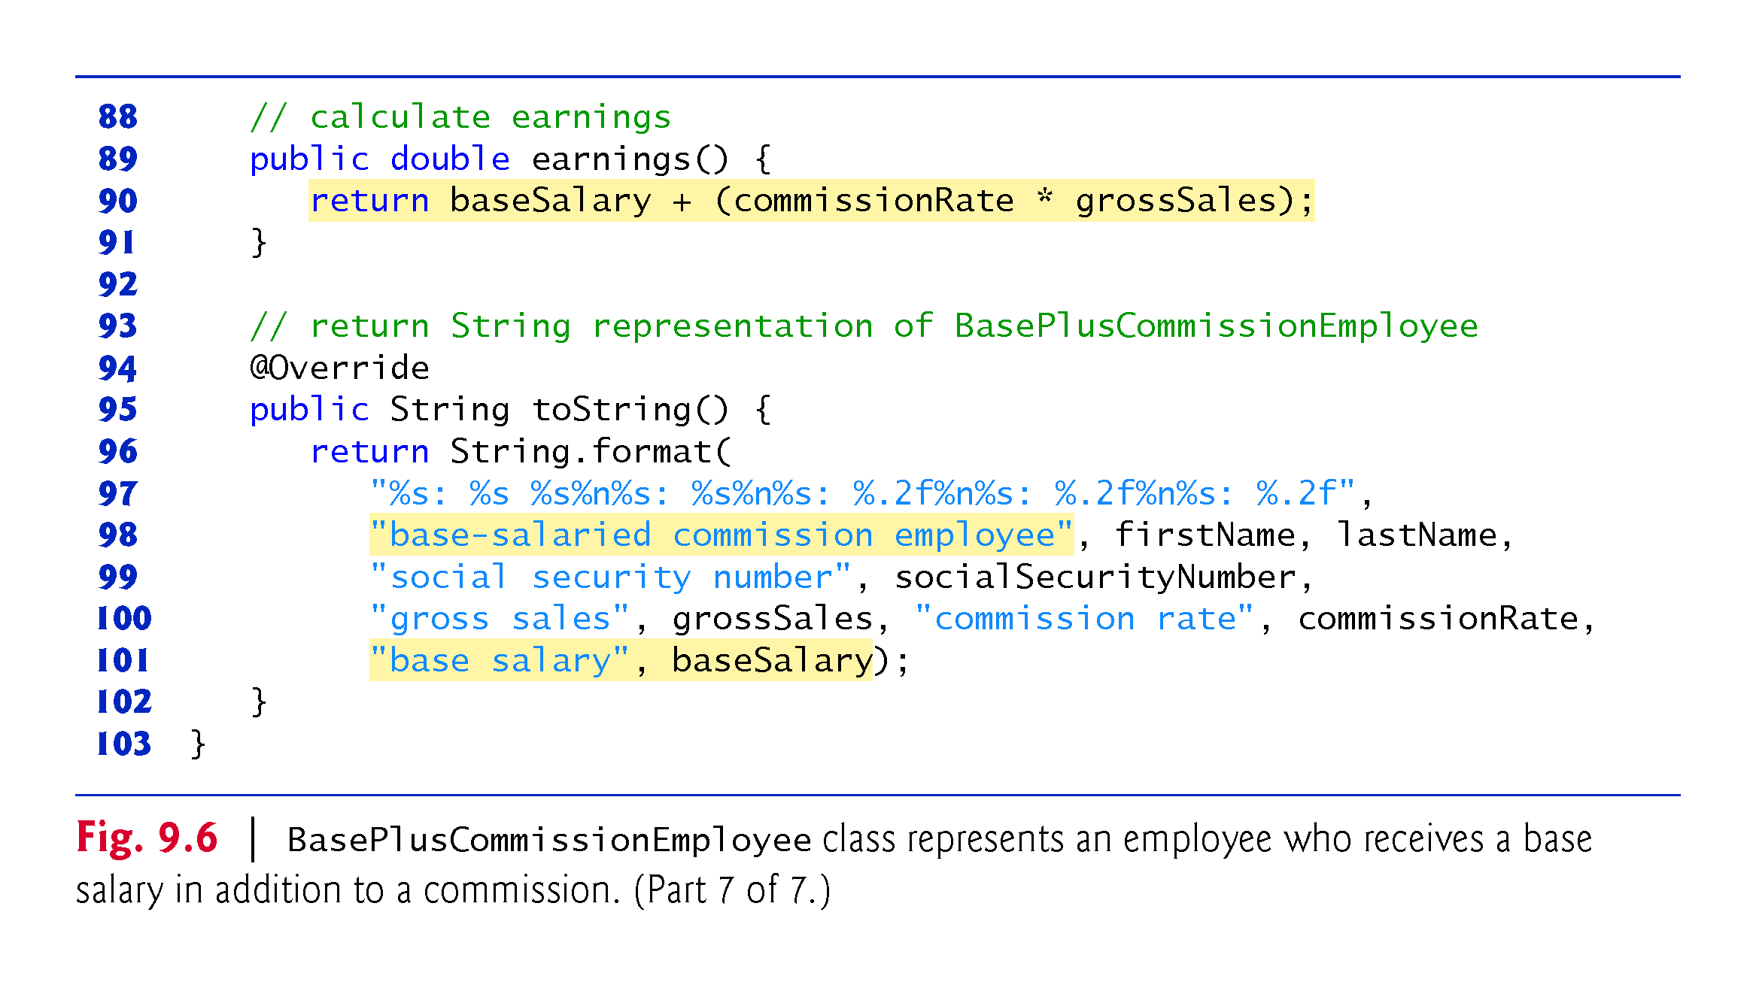

Slide 39
9.4.2 Creating and Using a BasePlus-CommissionEmployee Class (Cont.)
Class BasePlusCommissionEmployee does not specify “extends Object”
Implicitly extends Object.
BasePlusCommissionEmployee’s constructor invokes class Object’s default constructor implicitly.

Slide 40
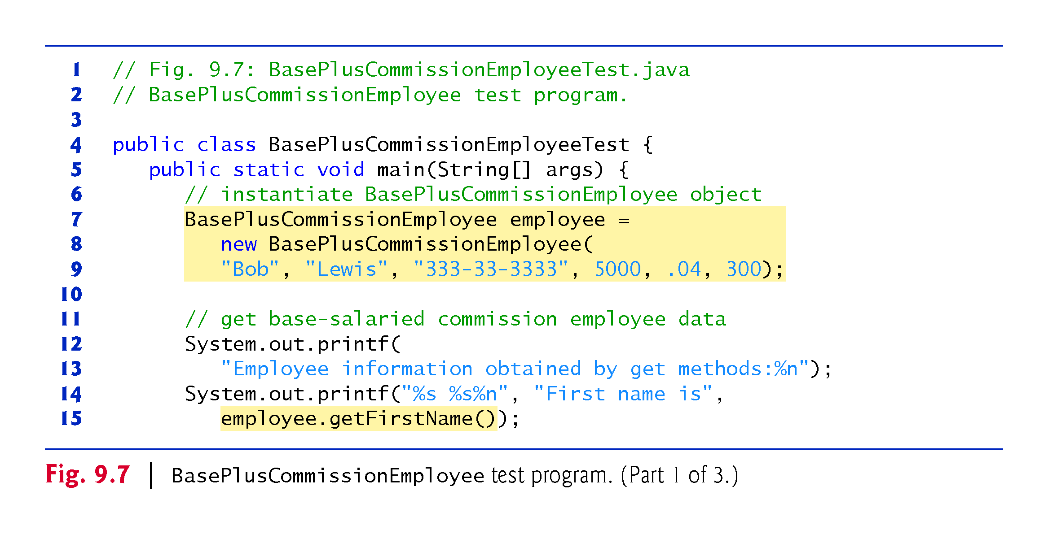

Slide 41
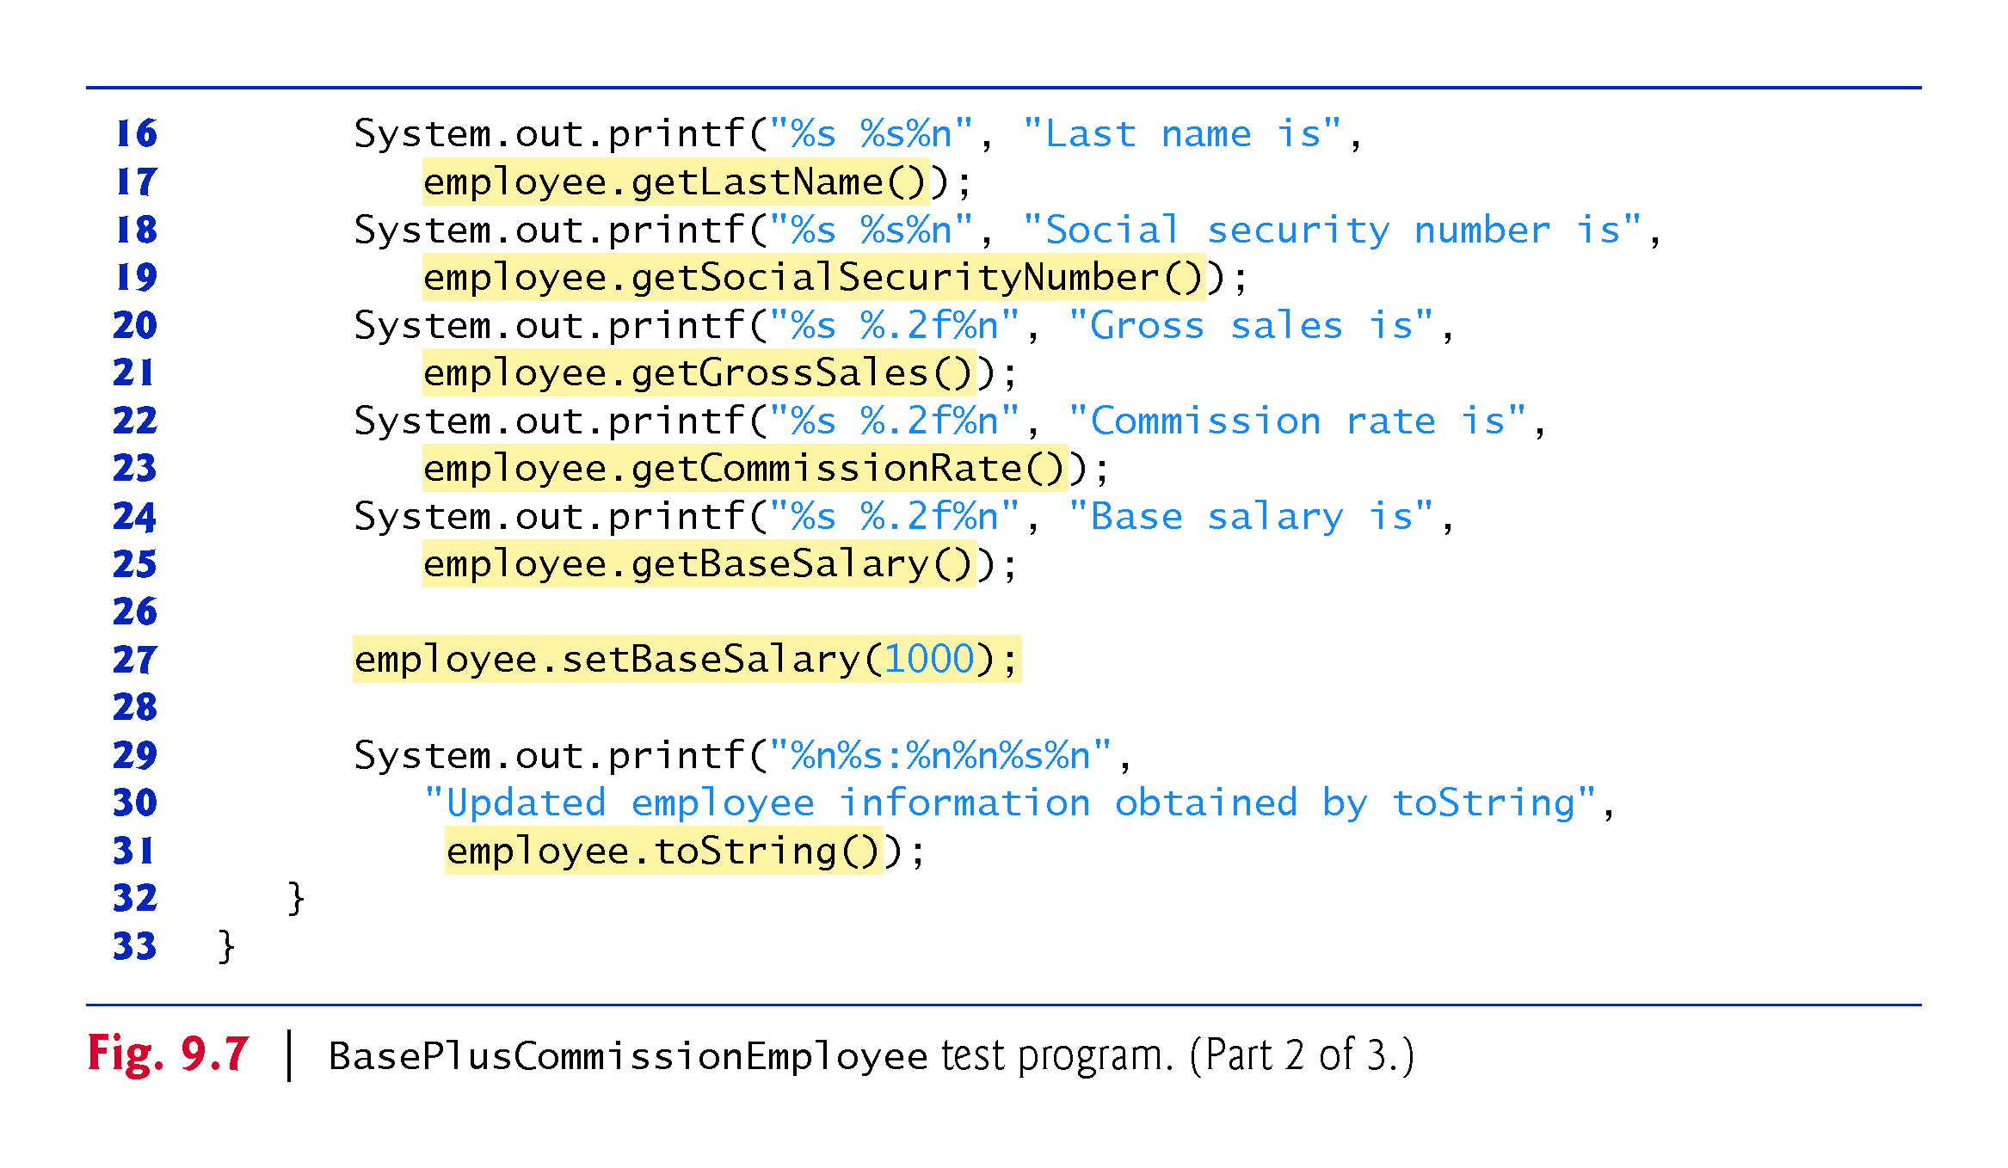

Slide 42
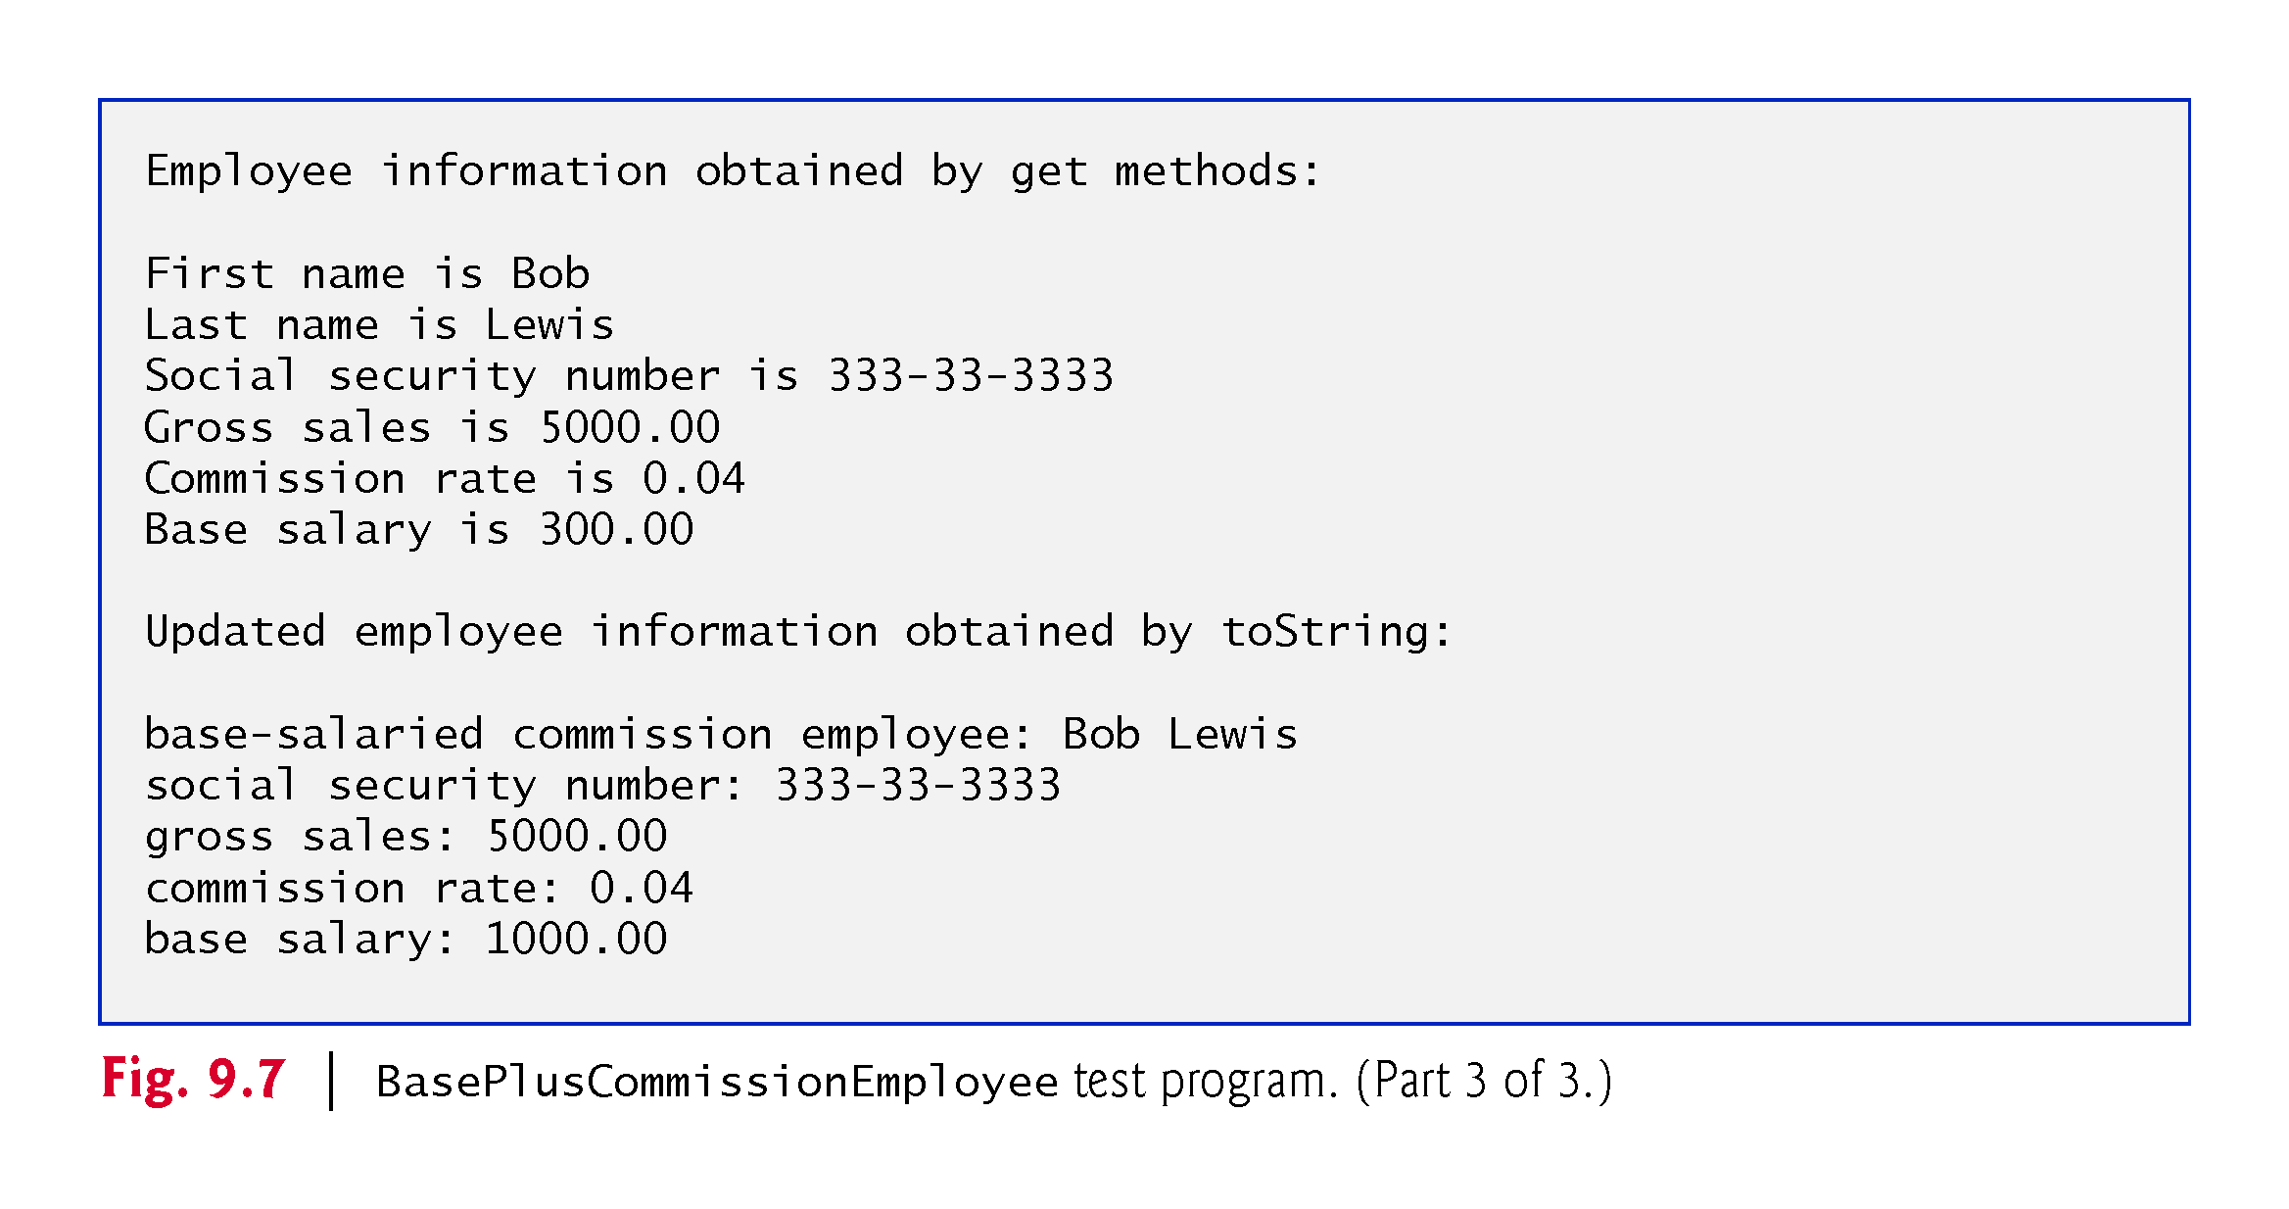

Slide 43
9.4.2 Creating and Using a BasePlus-CommissionEmployee Class (Cont.)
Much of BasePlusCommissionEmployee’s code is similar, or identical, to that of CommissionEmployee.
private instance variables firstName and lastName and methods setFirstName, getFirstName, setLastName and getLastName are identical.
Both classes also contain corresponding get and set methods.
The constructors are almost identical
BasePlusCommissionEmployee’s constructor also sets the baseSalary.
The toString methods are almost identical
BasePlusCommissionEmployee’s toString also outputs instance variable baseSalary

Slide 44
9.4.2 Creating and Using a BasePlus-CommissionEmployee Class (Cont.)
We literally copied CommissionEmployee’s code, pasted it into BasePlusCommissionEmployee, then modified the new class to include a base salary and methods that manipulate the base salary.
This “copy-and-paste” approach is often error prone and time consuming.
It spreads copies of the same code throughout a system, creating a code-maintenance problems—changes to the code would need to be made in multiple classes.

Slide 45
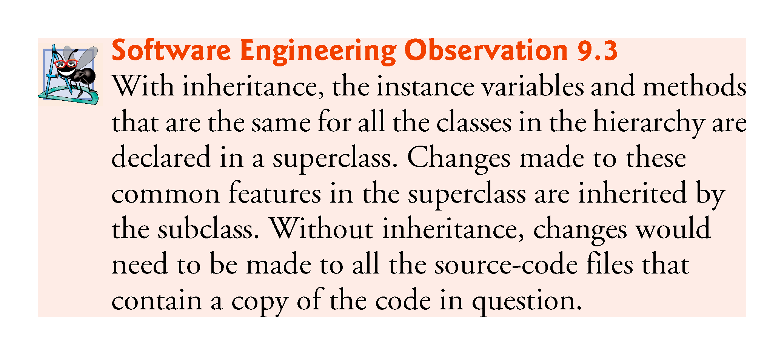

Slide 46
9.4.3 Creating a CommissionEmployee–BasePlusCommissionEmployee Inheritance Hierarchy
Class BasePlusCommissionEmployee class extends class CommissionEmployee
A BasePlusCommissionEmployee object is a CommissionEmployee
Inheritance passes on class CommissionEmployee’s capabilities.
Class BasePlusCommissionEmployee also has instance variable baseSalary.
Subclass BasePlusCommissionEmployee inherits CommissionEmployee’s instance variables and methods
Only CommissionEmployee’s public and protected members are directly accessible in the subclass.

Slide 47
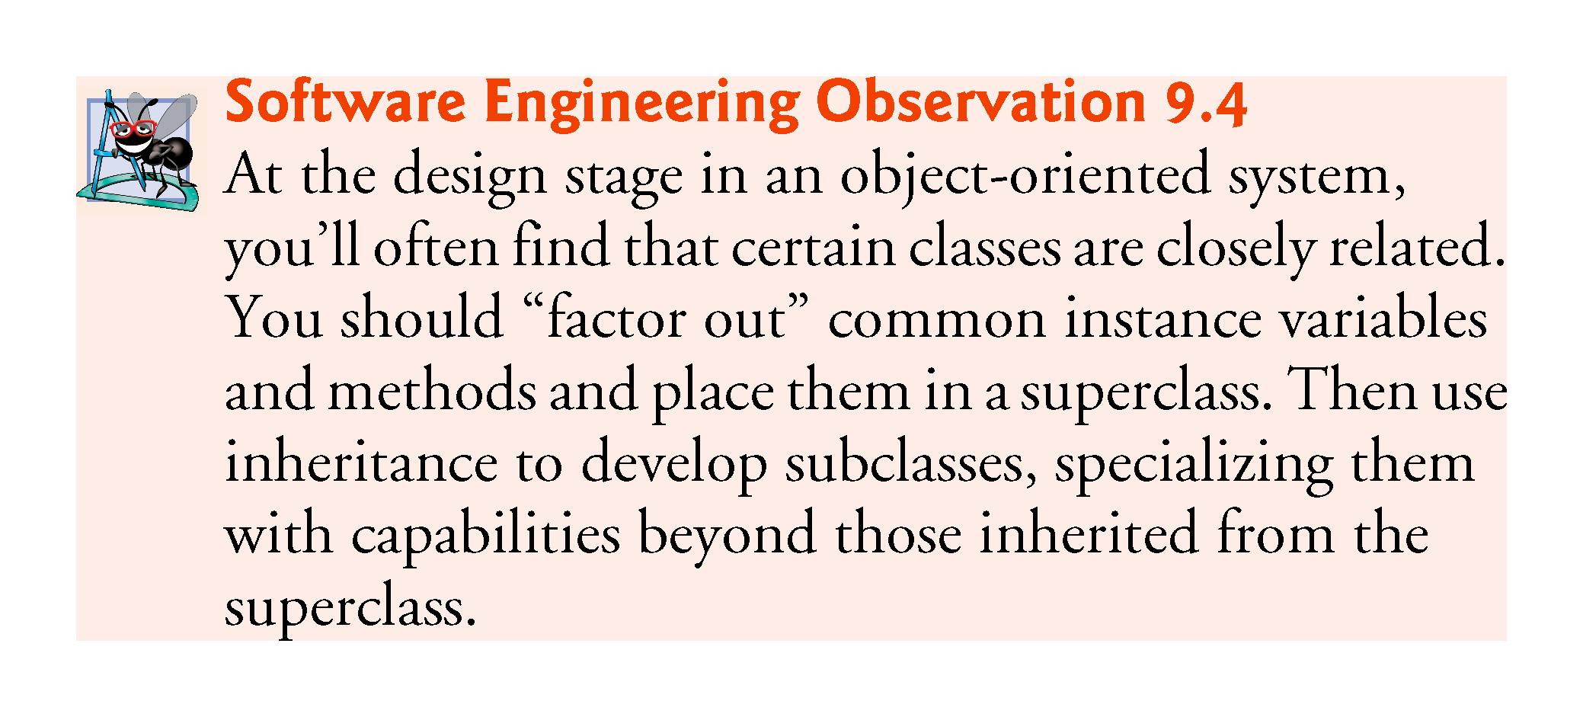

Slide 48
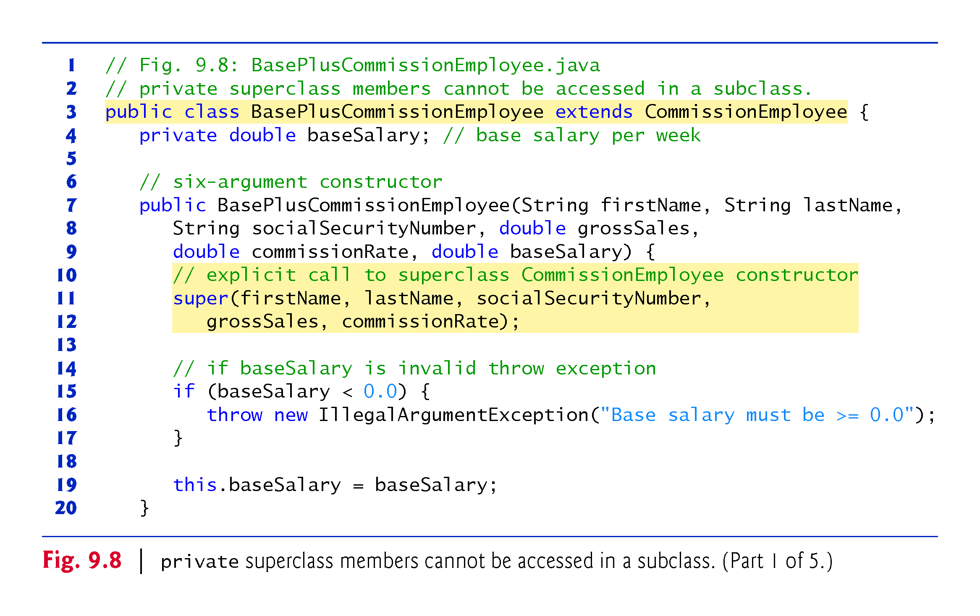

Slide 49
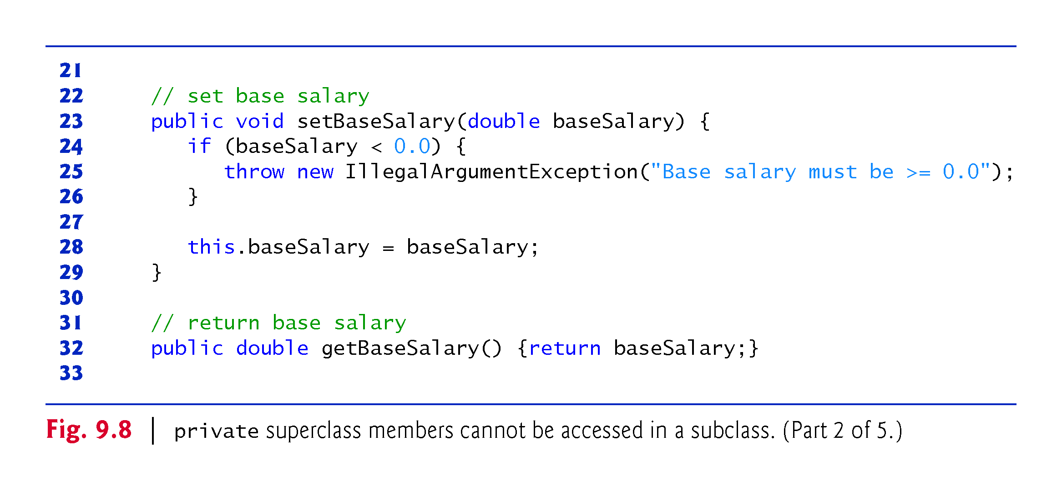

Slide 50
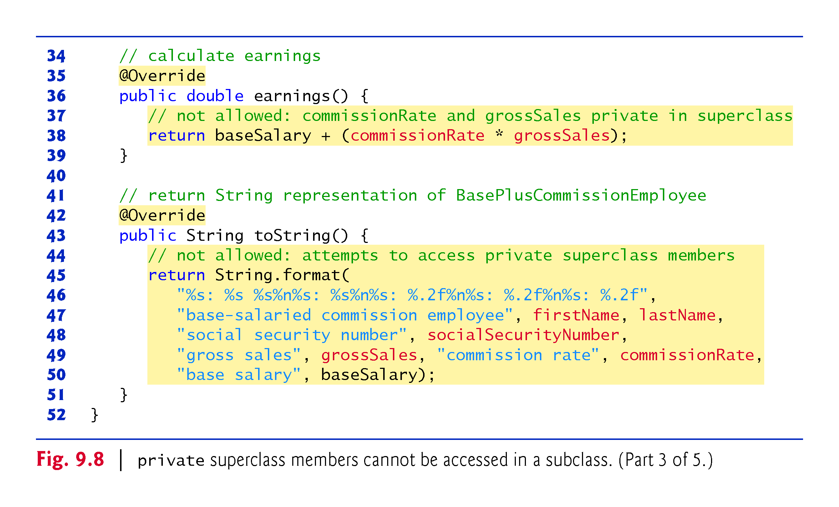

Slide 51
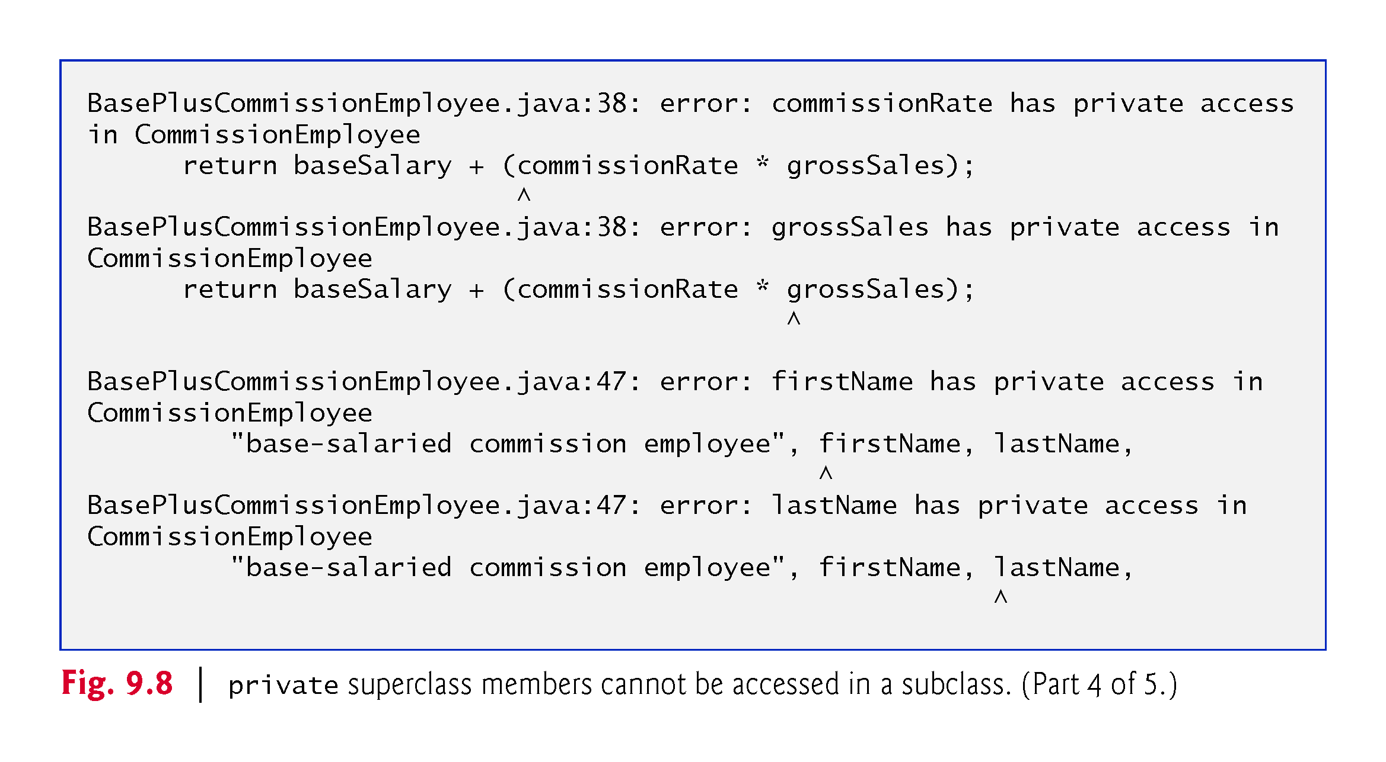

Slide 52
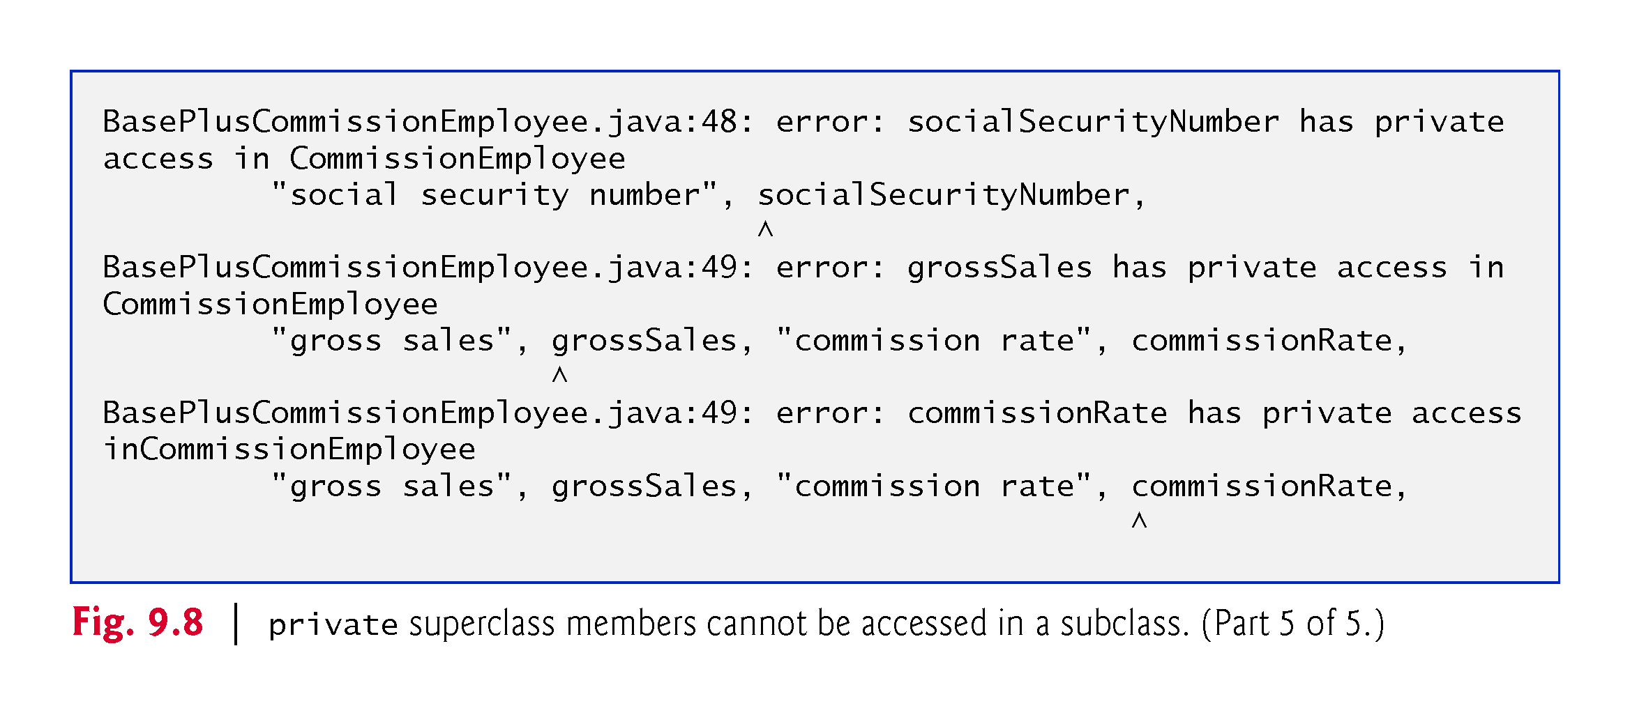

Slide 53
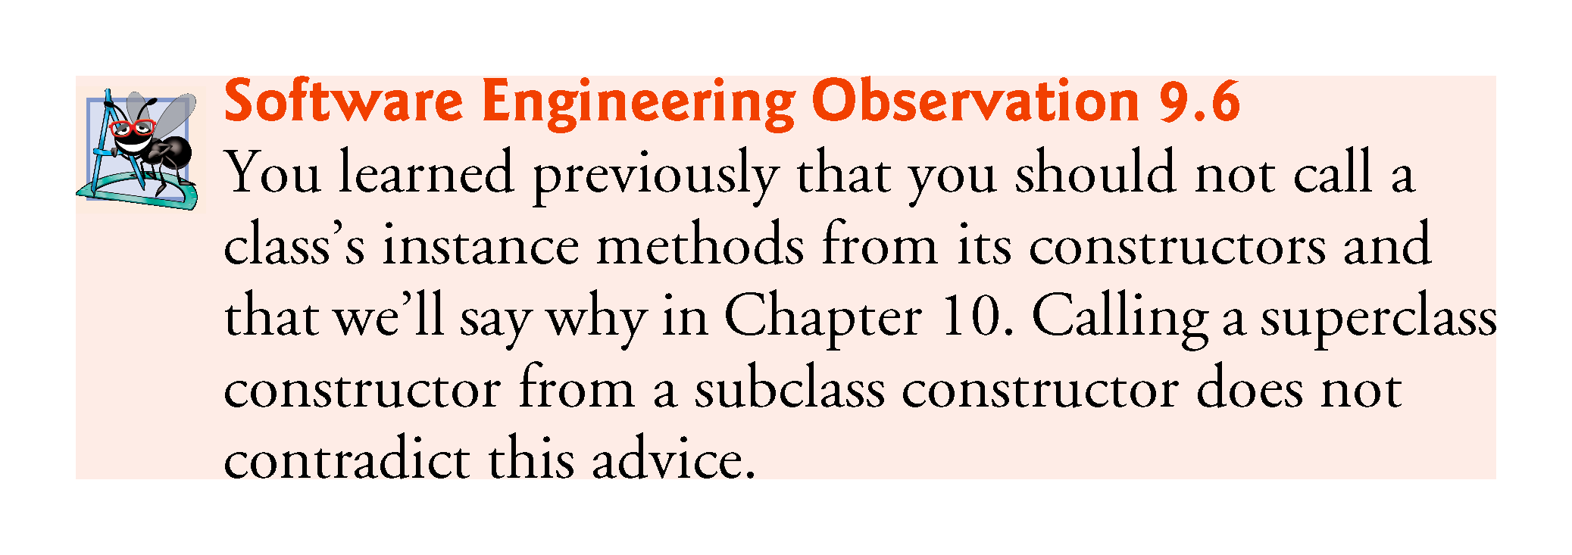

Slide 54
9.4.4 CommissionEmployee–BasePlusCommissionEmployee Inheritance Hierarchy Using protected Instance Variables
To enable a subclass to directly access superclass instance variables, we can declare those members as protected in the superclass.
New CommissionEmployee class modified only the instance variable declarations of Fig. 9.4 as follows:
protected final String firstName; protected final String lastName; protected final String socialSecurityNumber; protected double grossSales; protected double commissionRate;
With protected instance variables, the subclass gets access to the instance variables, but classes that are not subclasses and classes that are not in the same package cannot access these variables directly.

Slide 55
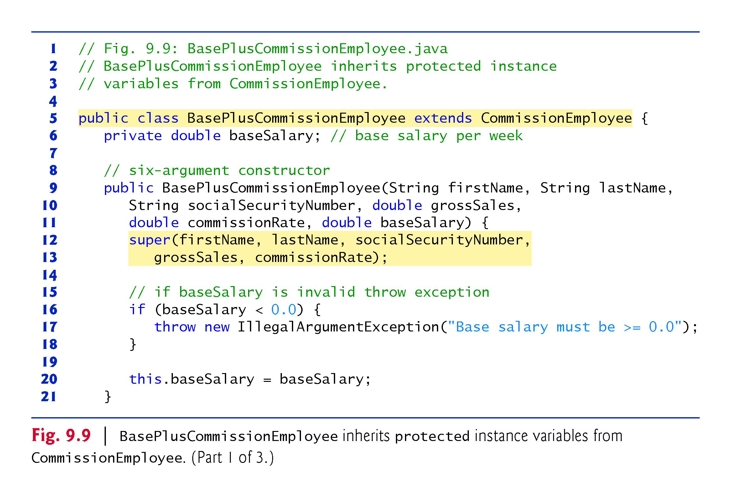

Slide 56
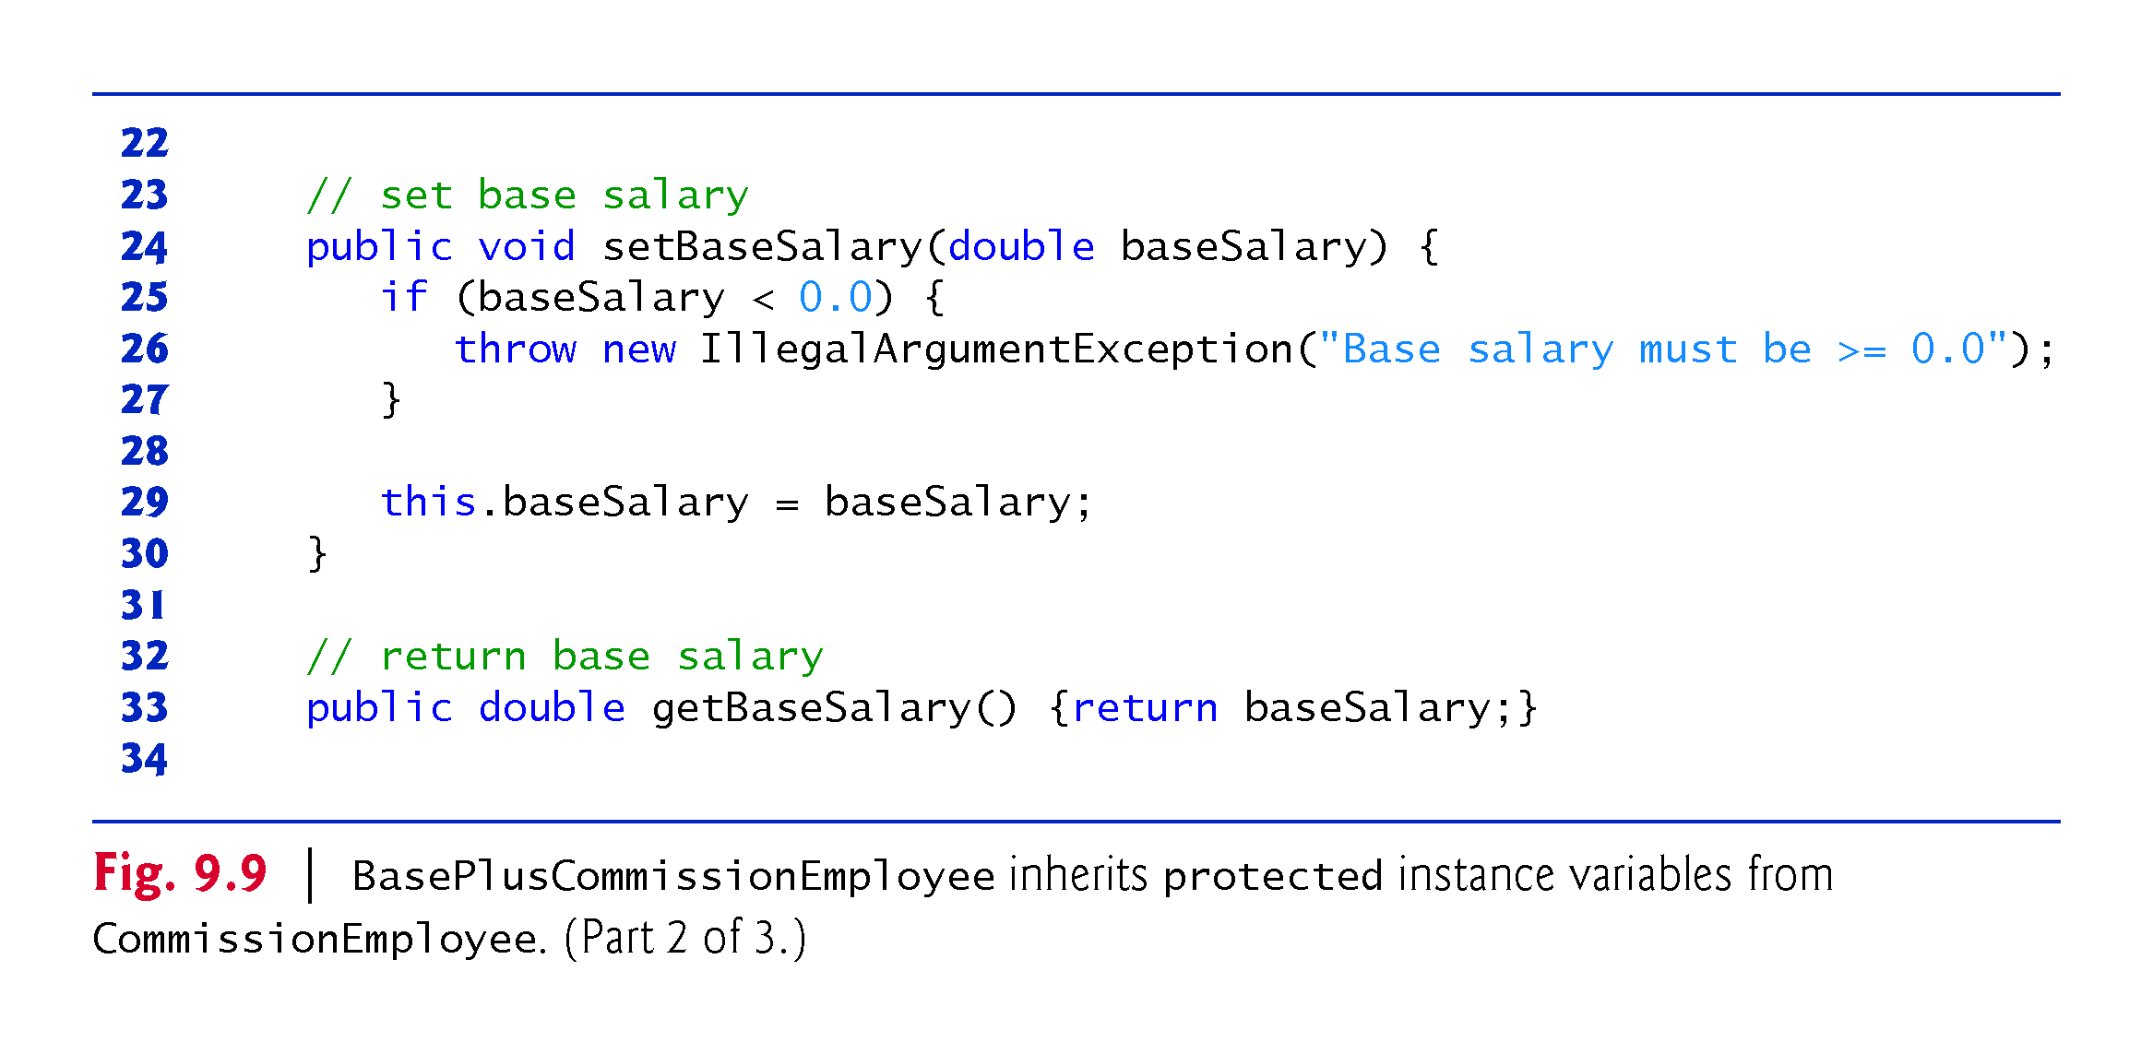

Slide 57
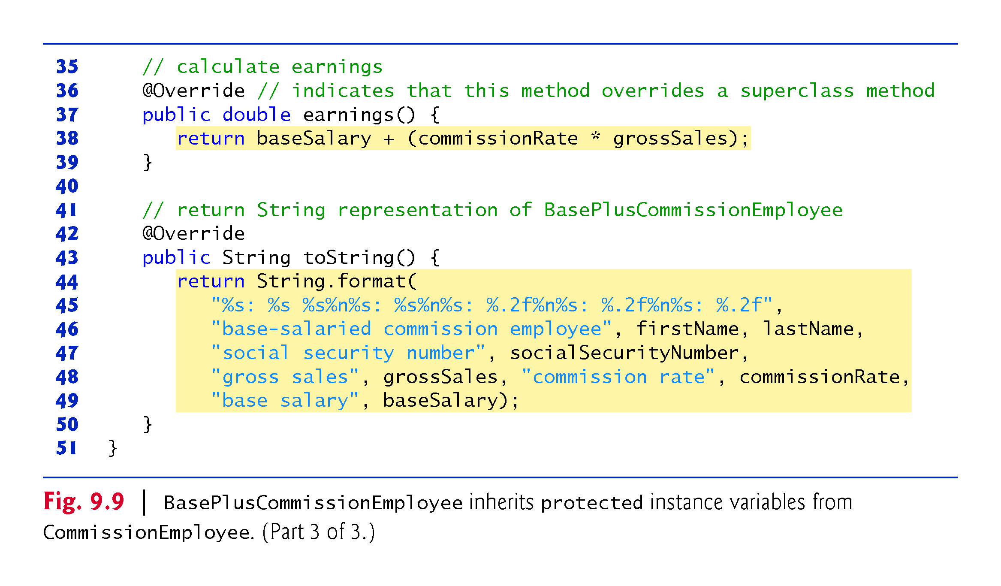

Slide 58
9.4.4 CommissionEmployee–BasePlus-CommissionEmployee Inheritance Hierarchy Using protected Instance Variables (Cont.)
Using protected instance variables creates several potential problems.
The subclass object can set an inherited variable’s value directly without using a set method.
A subclass object can assign an invalid value to the variable
Subclass methods are more likely to be written so that they depend on the superclass’s data implementation.
Subclasses should depend only on the superclass services and not on the superclass data implementation.

Slide 59
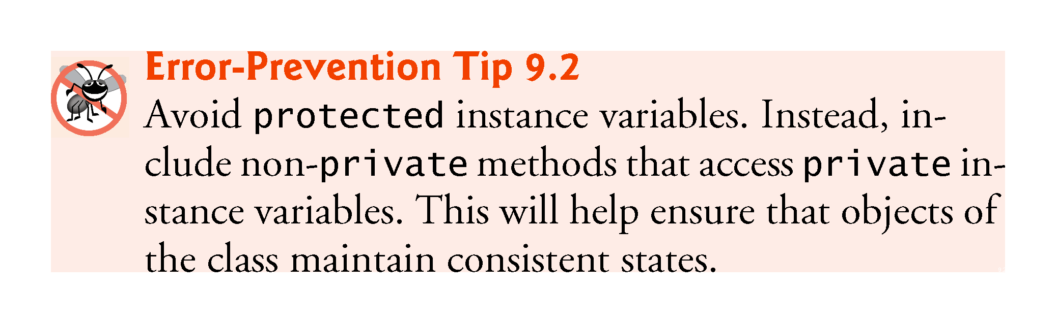

Slide 60
9.4.5 CommissionEmployee–BasePlus-CommissionEmployee Inheritance Hierarchy Using private Instance Variables
Class CommissionEmployee declares instance variables firstName, lastName, socialSecurityNumber, grossSales and commissionRate as private and provides public methods for manipulating these values.

Slide 61
9.4.5 CommissionEmployee–BasePlus-CommissionEmployee Inheritance Hierarchy Using private Instance Variables (Cont.)
CommissionEmployee methods earnings and toString use the class’s get methods to obtain the values of its instance variables.
If we decide to change the internal representation of the data (e.g., variable names) only the bodies of the get and set methods that directly manipulate the instance variables will need to change.
These changes occur solely within the superclass-—no changes to the subclass are needed.
Localizing the effects of changes like this is a good software engineering practice.
Subclass BasePlusCommissionEmployee inherits Commission-Employee’s non-private methods and can access the private superclass members via those methods.

Slide 62
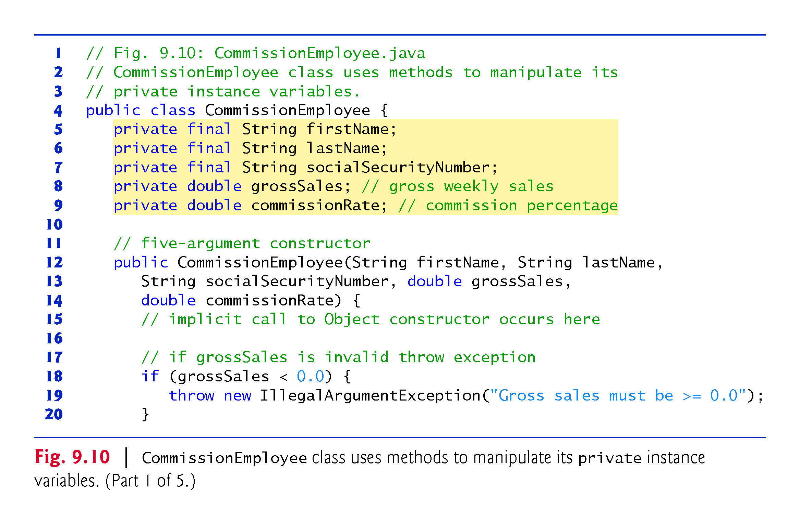

Slide 63
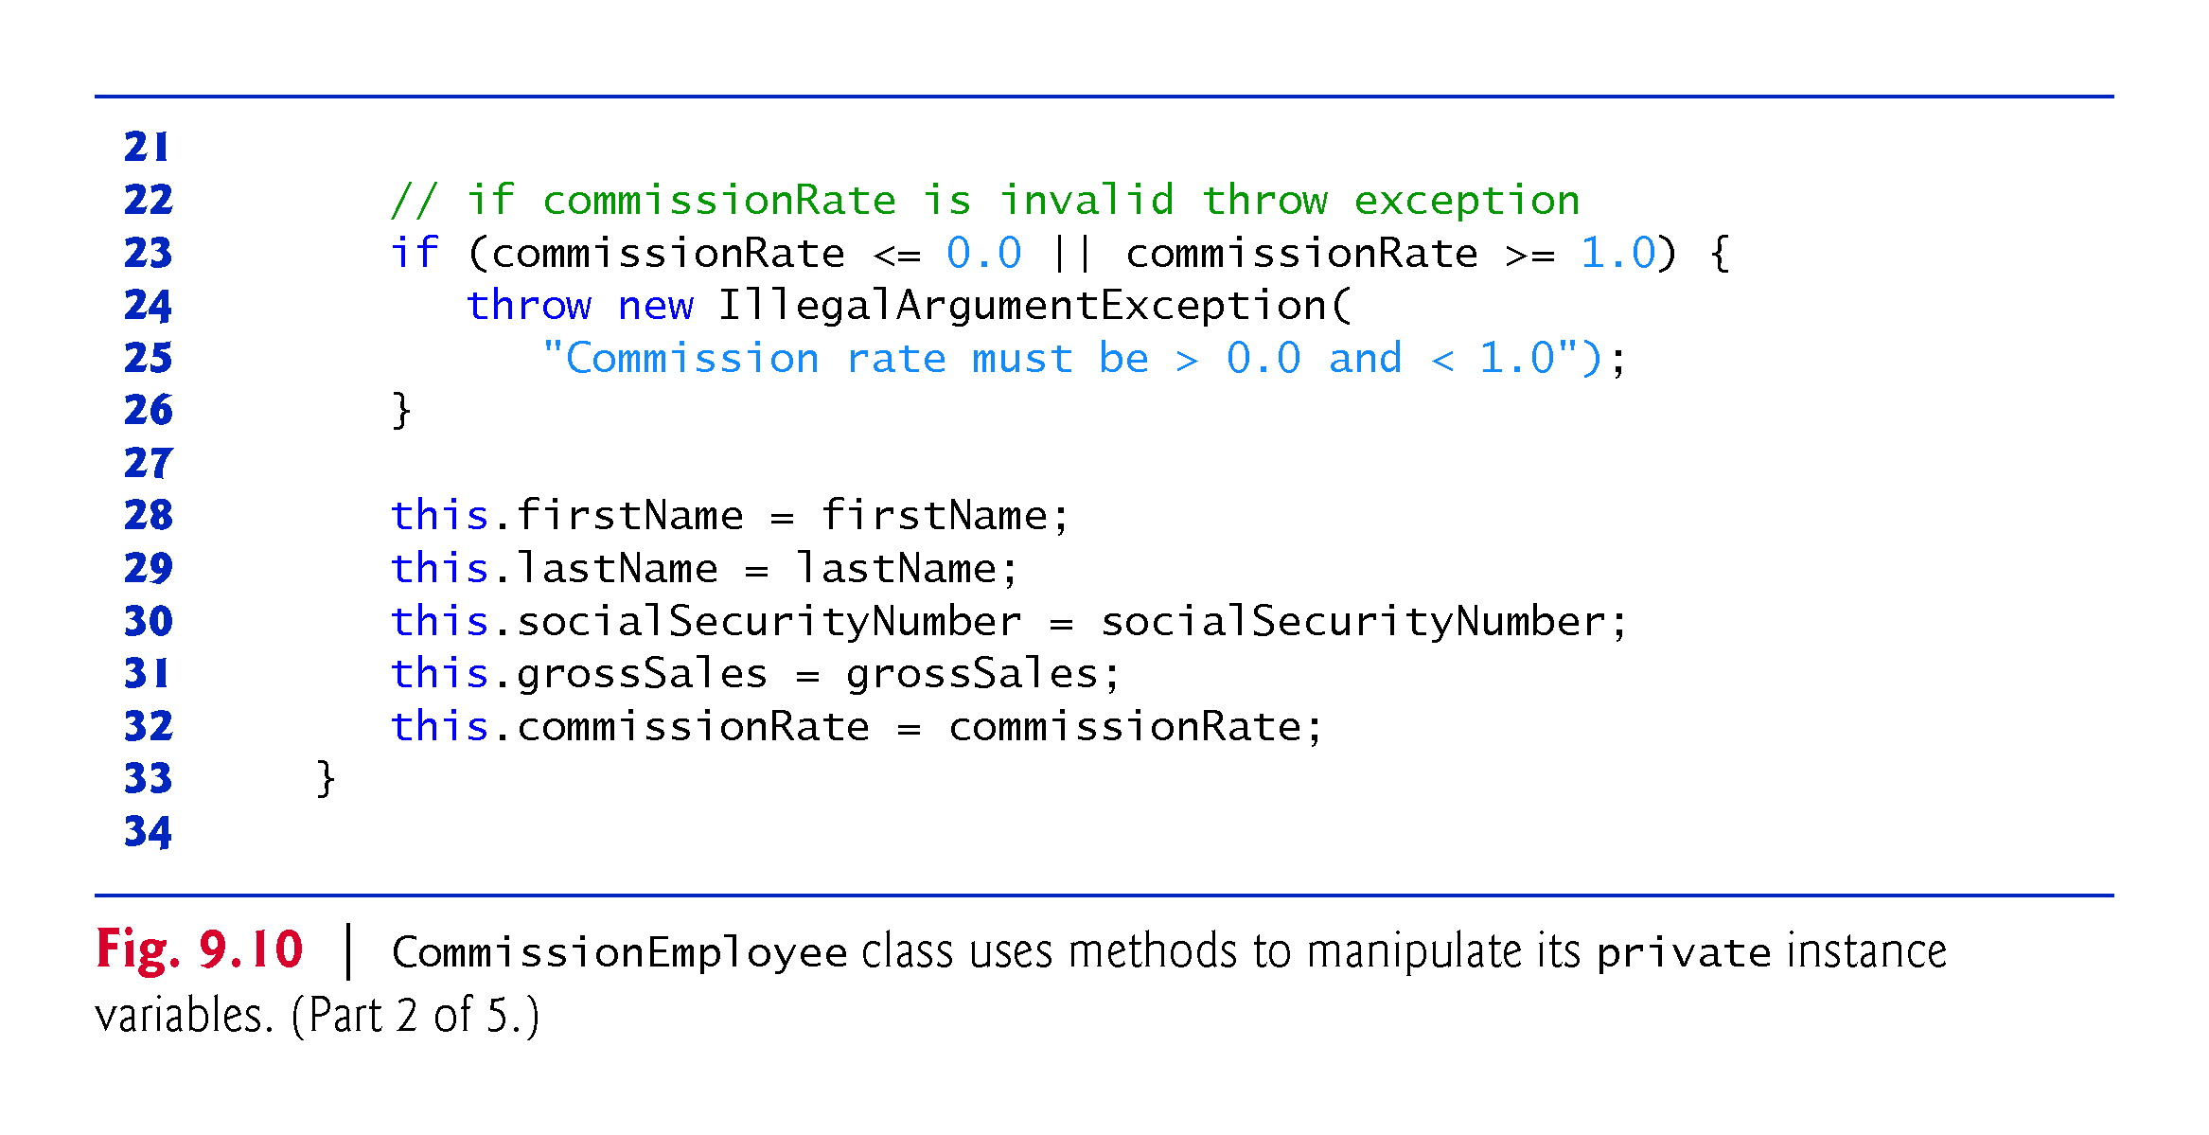

Slide 64
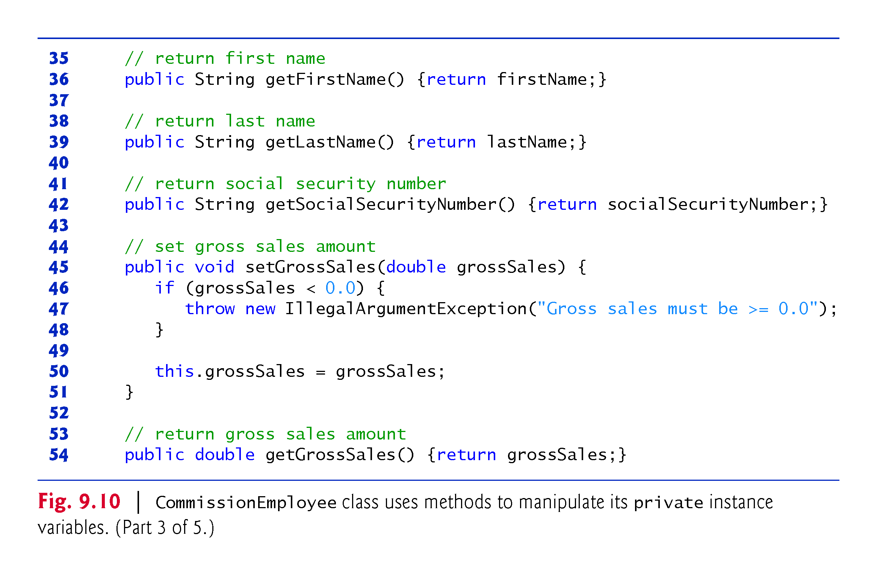

Slide 65
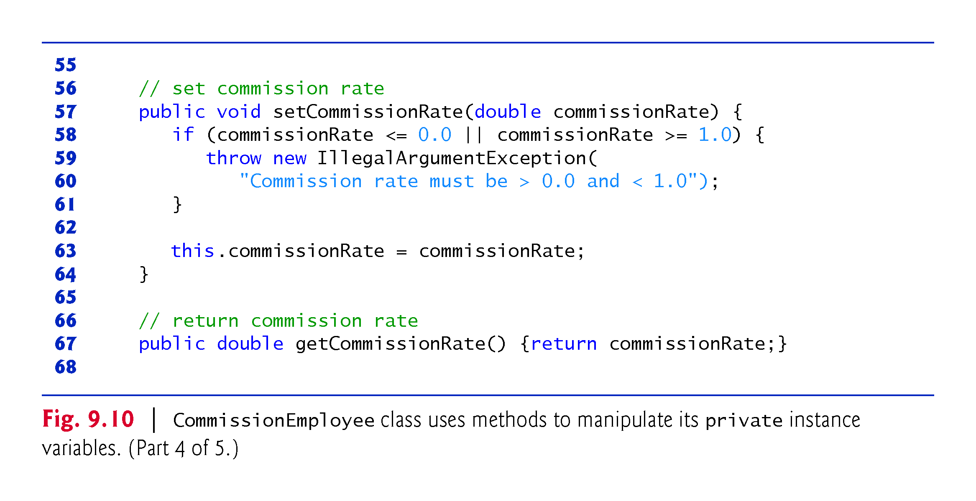

Slide 66
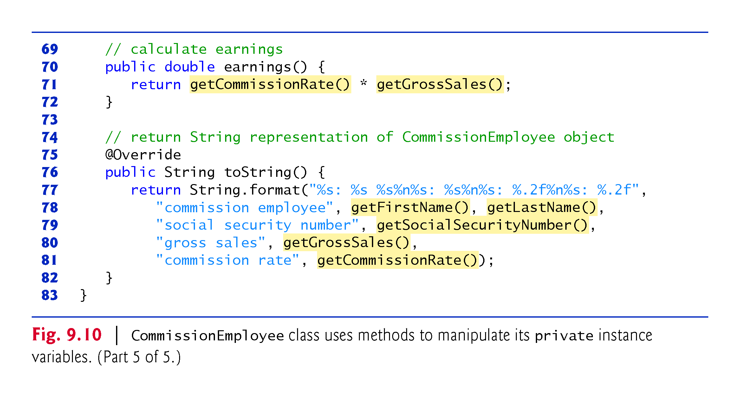

Slide 67
9.4.5 CommissionEmployee–BasePlus-CommissionEmployee Inheritance Hierarchy Using private Instance Variables (Cont.)
Class BasePlusCommissionEmployee (Fig. 9.11) has several changes that distinguish it from Fig. 9.9.
Methods earnings and toString each invoke their superclass versions and do not access instance variables directly.

Slide 68
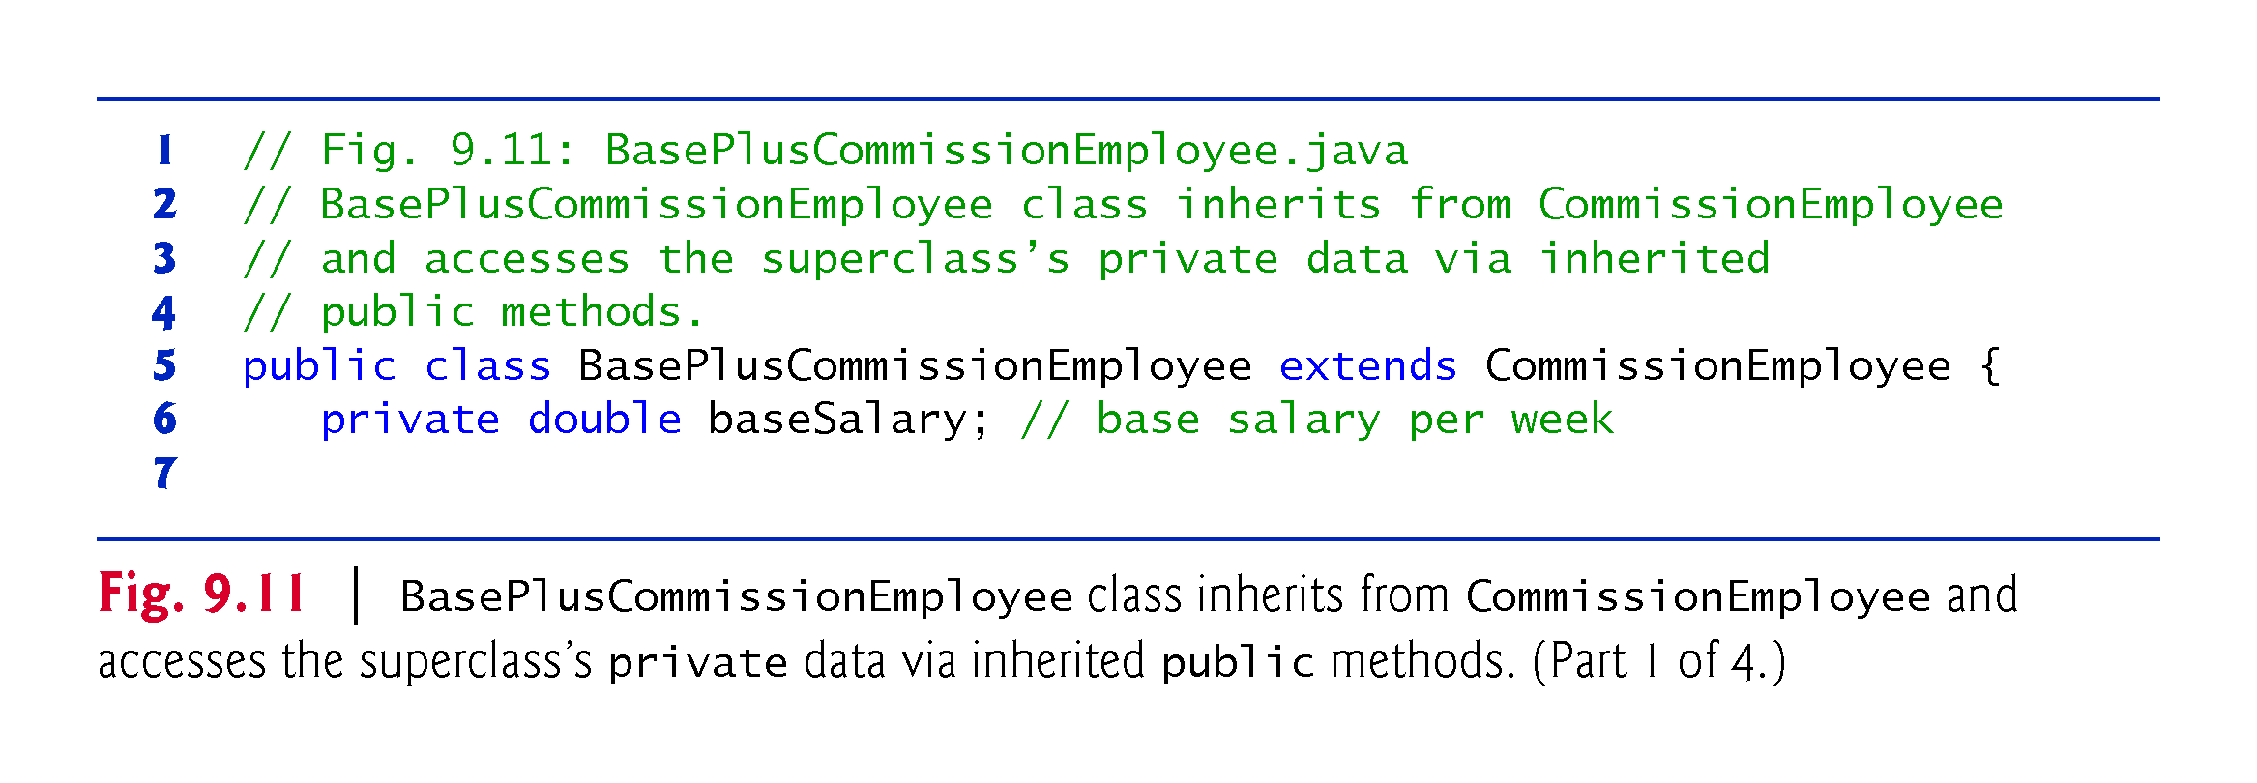

Slide 69
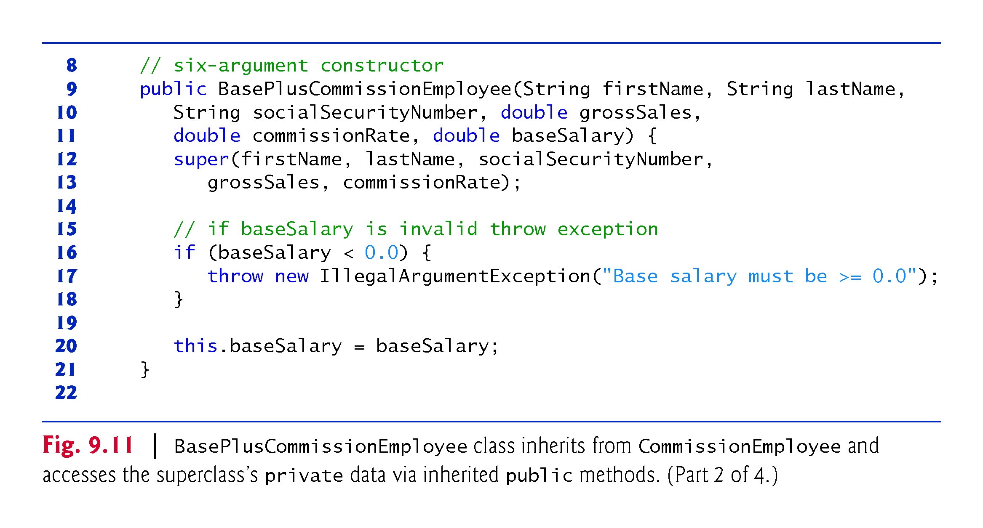

Slide 70
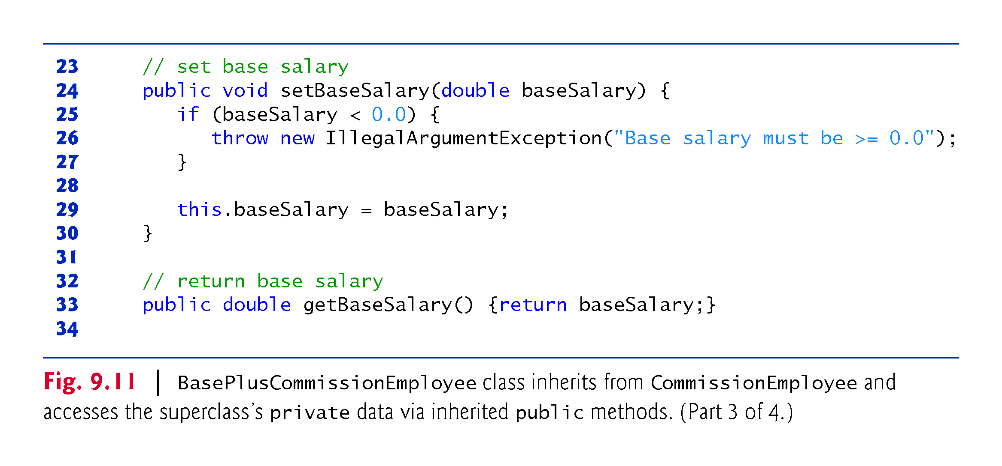

Slide 71
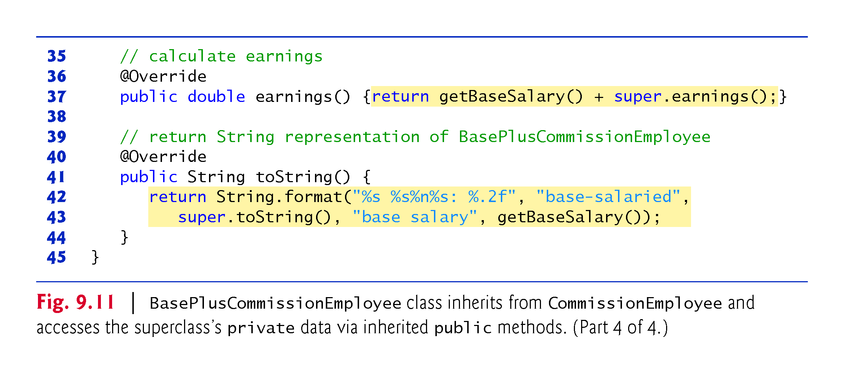

Slide 72
9.4.5 CommissionEmployee–BasePlus-CommissionEmployee Inheritance Hierarchy Using private Instance Variables (Cont.)
Method earnings overrides class the superclass’s earnings method.
The new version calls CommissionEmployee’s earnings method with super.earnings().
Obtains the earnings based on commission alone
Placing the keyword super and a dot (.) separator before the superclass method name invokes the superclass version of an overridden method.
Good software engineering practice
If a method performs all or some of the actions needed by another method, call that method rather than duplicate its code.

Slide 73
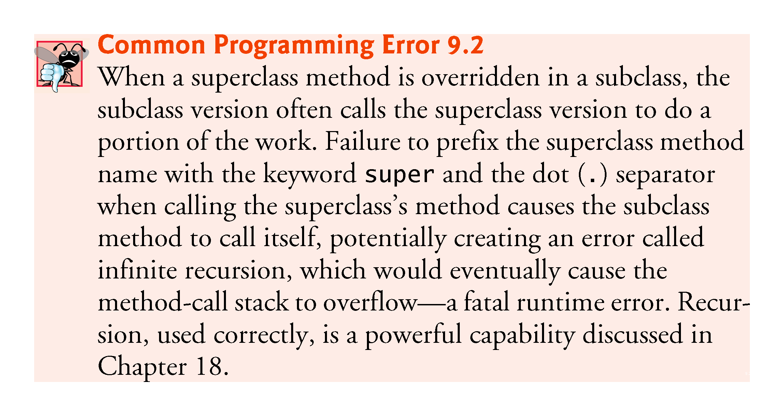

Slide 74
9.4.5 CommissionEmployee–BasePlus-CommissionEmployee Inheritance Hierarchy Using private Instance Variables (Cont.)
BasePlusCommissionEmployee’s toString method overrides class CommissionEmployee’s toString method.
The new version creates part of the String representation by calling CommissionEmployee’s toString method with the expression super.toString().

Slide 75
9.5 Constructors in Subclasses
Instantiating a subclass object begins a chain of constructor calls
The subclass constructor, before performing its own tasks, explicitly uses super to call one of the constructors in its direct superclass or implicitly calls the superclass’s default or no-argument constructor
If the superclass is derived from another class, the superclass constructor invokes the constructor of the next class up the hierarchy, and so on.
The last constructor called in the chain is always Object’s constructor.
Original subclass constructor’s body finishes executing last.
Each superclass’s constructor manipulates the superclass instance variables that the subclass object inherits.

Slide 76
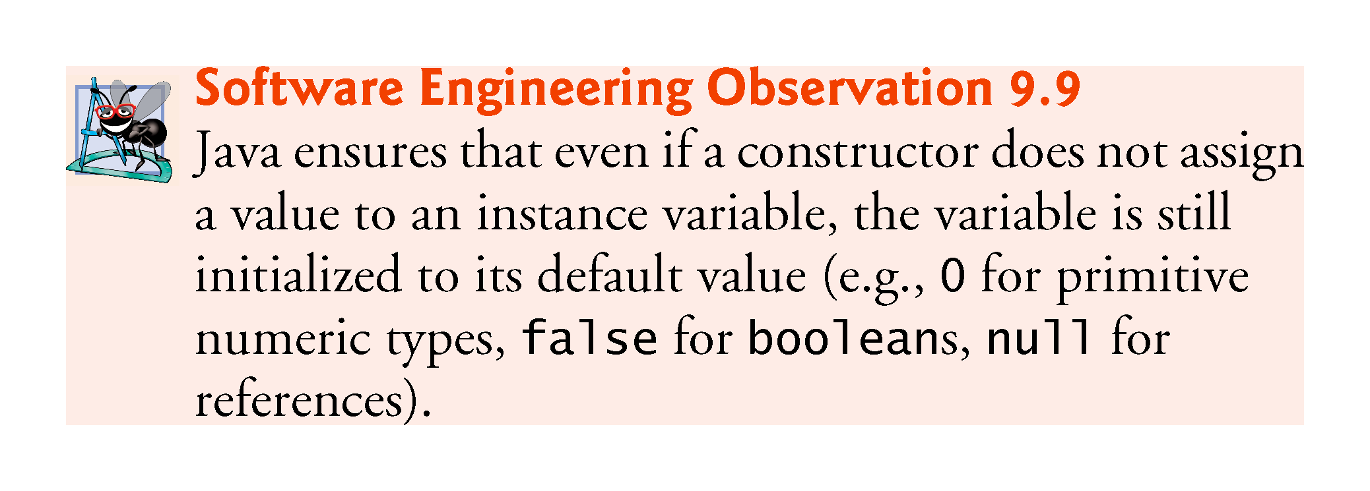

Slide 77
9.6 Class Object
All classes in Java inherit directly or indirectly from class Object, so its 11 methods are inherited by all other classes.
Figure 9.12 summarizes Object’s methods.
Every array has an overridden clone method that copies the array.
If the array stores references to objects, the objects are not copied—a shallow copy is performed.

Slide 78
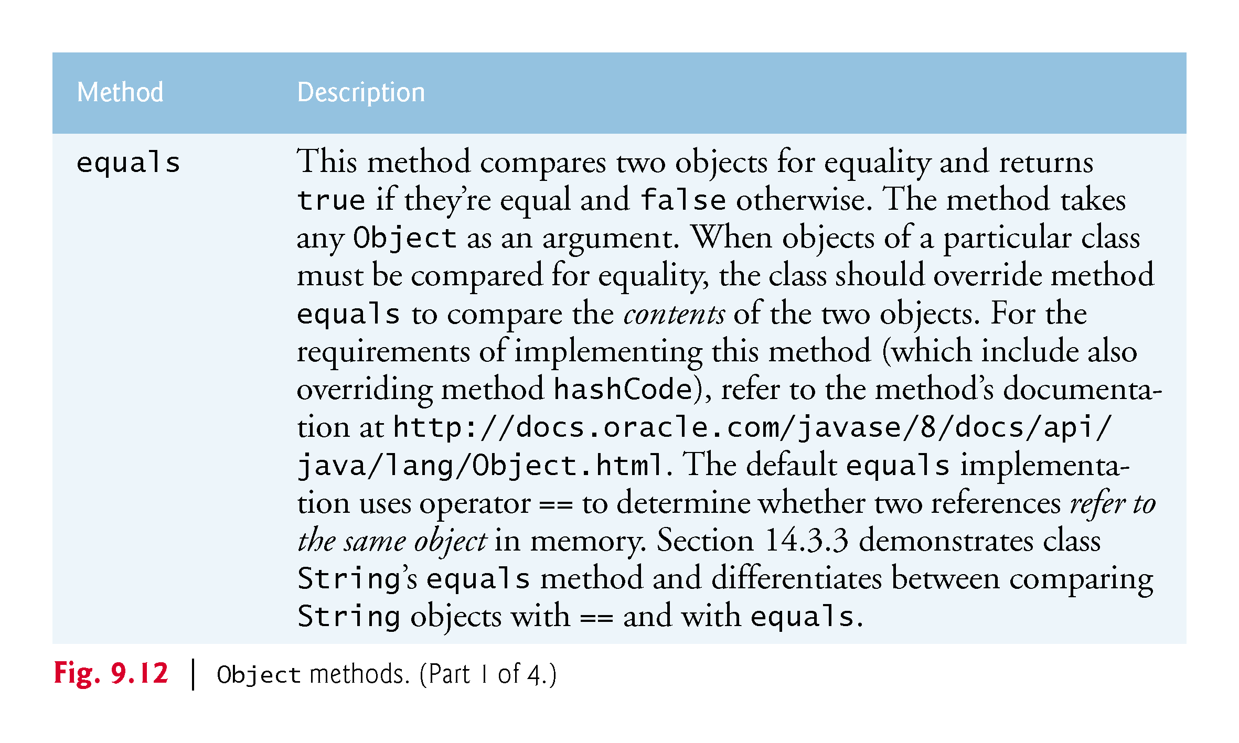

Slide 79
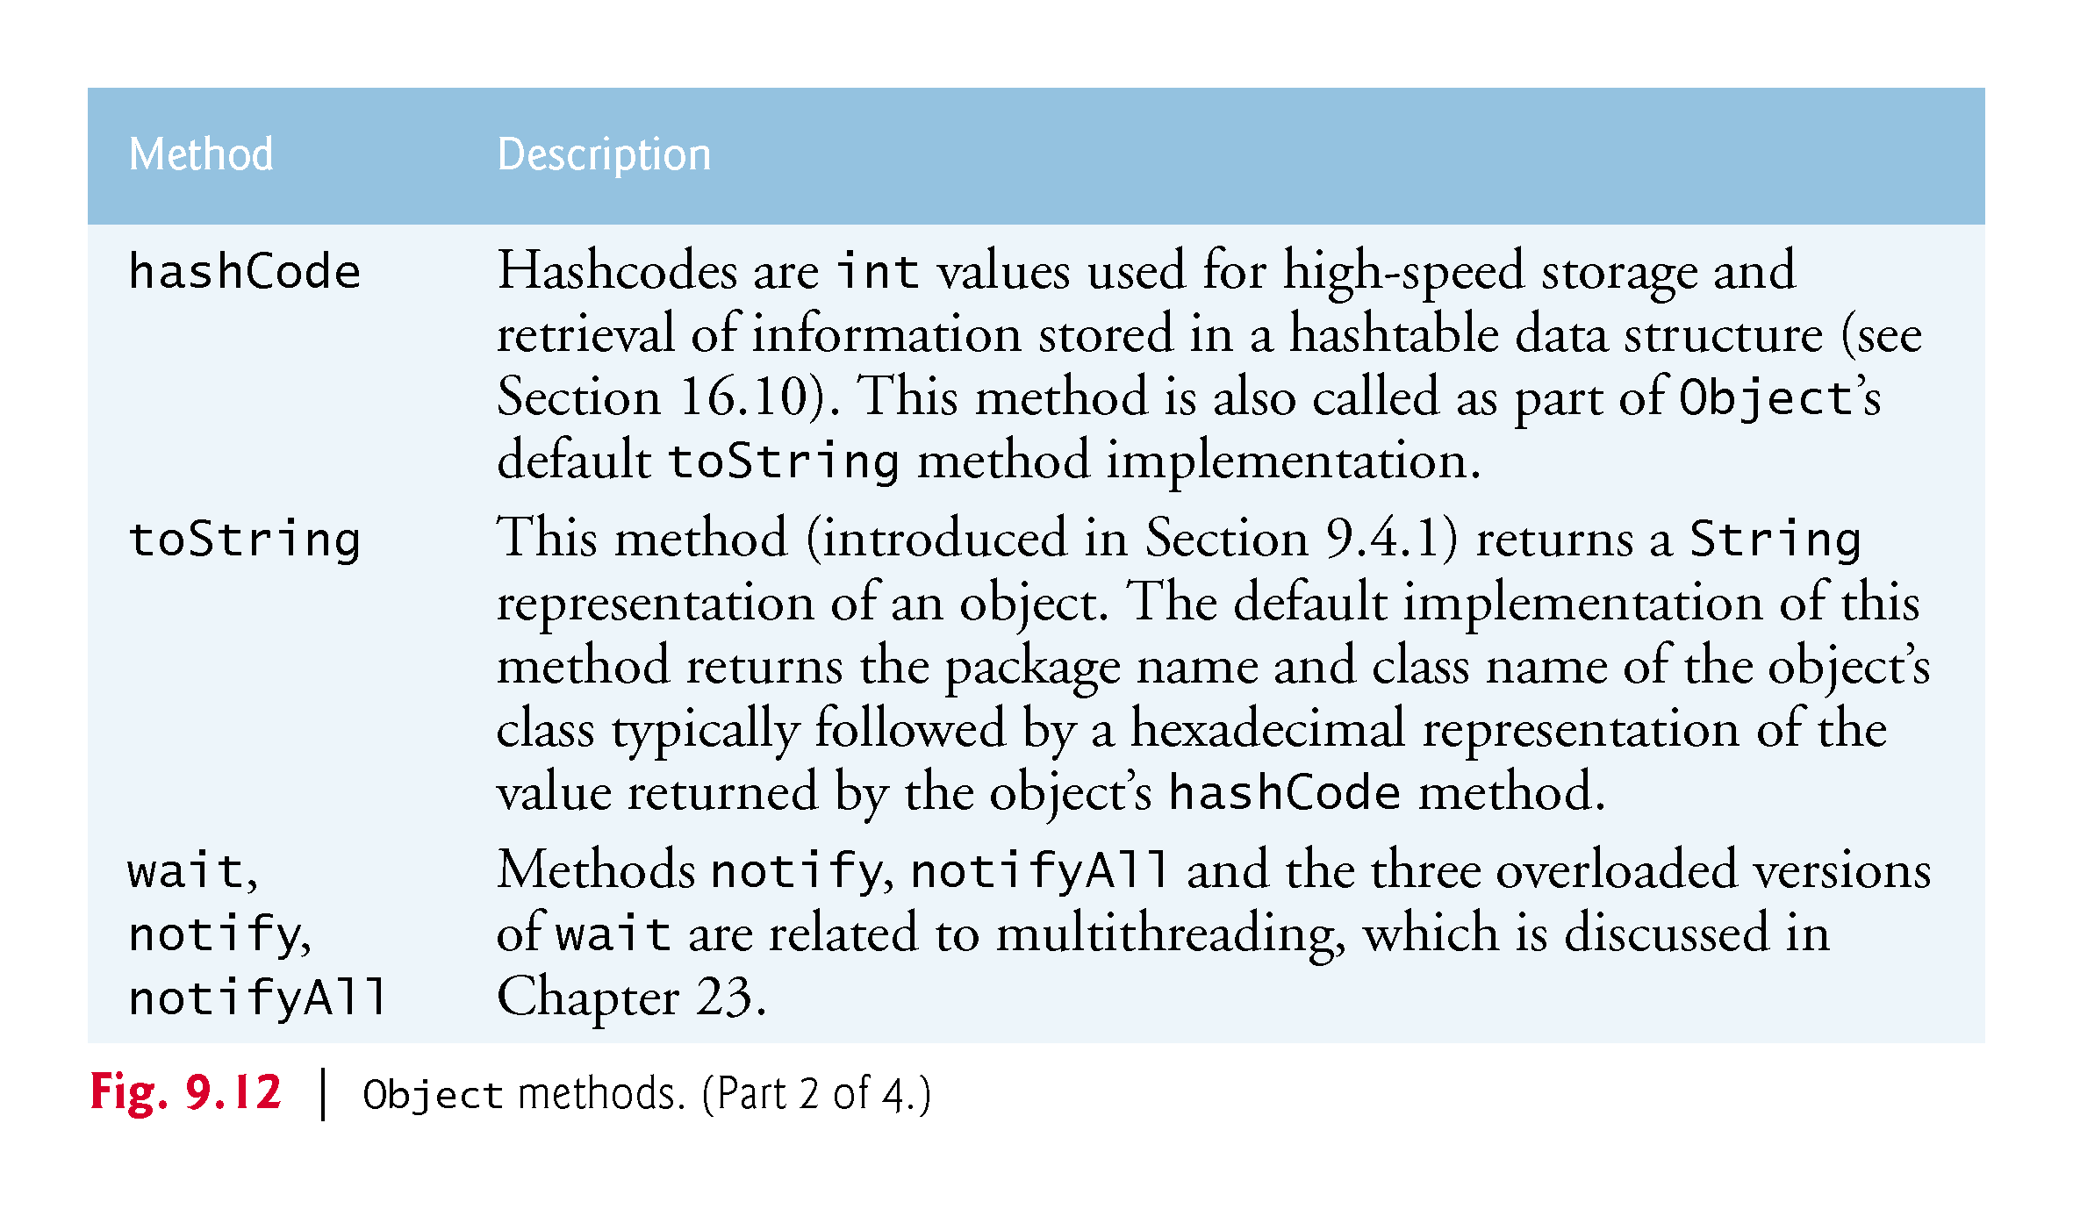

Slide 80
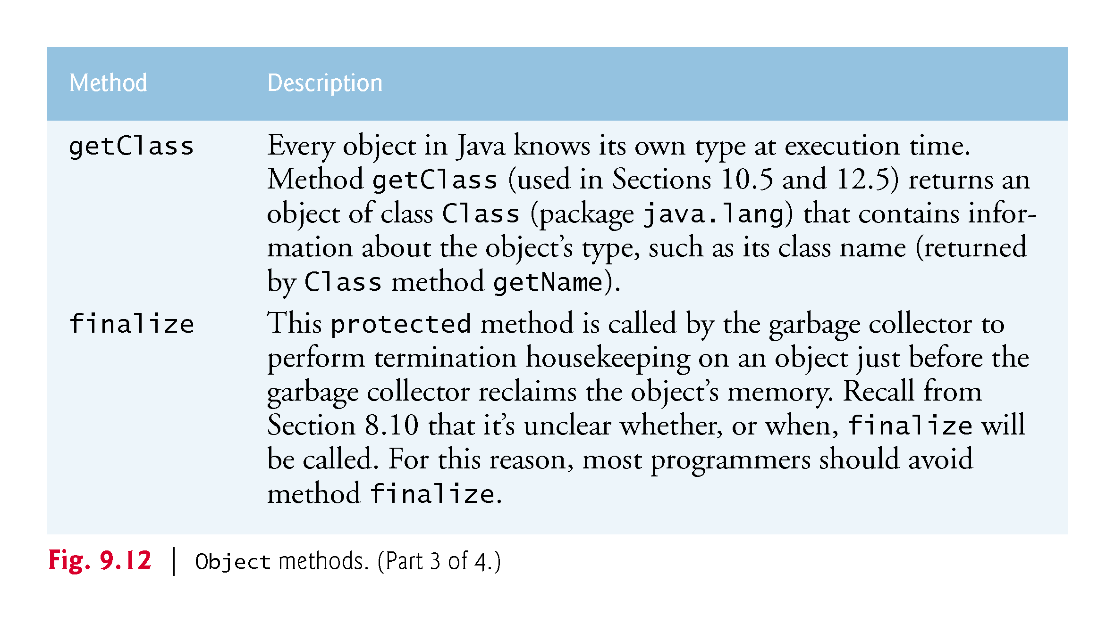

Slide 81


Slide 82
9.7 Designing with Composition vs. Inheritance
There’s much discussion in the software engineering community about the relative merits of composition and inheritance
Each has its own place, but inheritance is often overused and composition is more appropriate in many cases
A mix of composition and inheritance often is a reasonable design approach, as you’ll see in Exercise 9.16

